Slide 1
2025–26 FAFSA® Preview Presentation
October 2024

Slide 2
Dependent Student Invites Parent

Slide 3
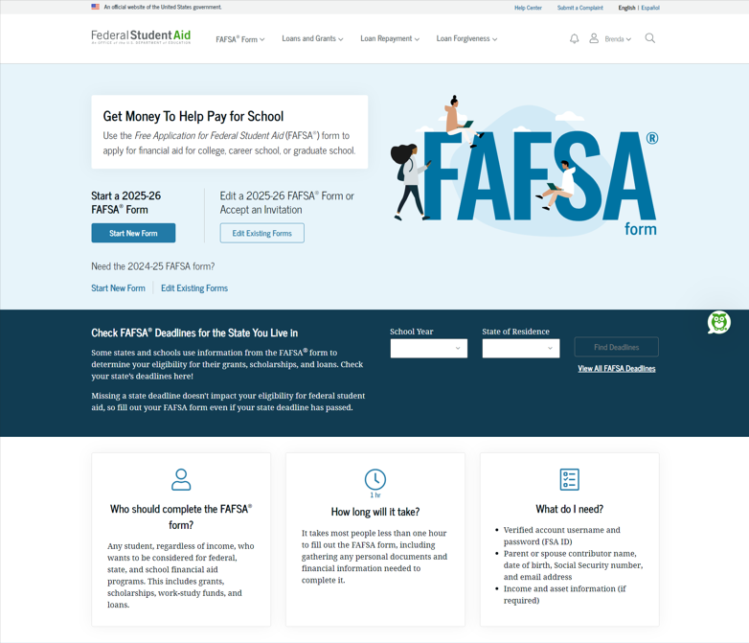
Dependent Student FAFSA® Landing Page
This is the main FAFSA® landing page. On this page, students are directed to "Start New Form" or “Edit Existing Forms." For this section of the presentation, the student is beginning a new application.

Slide 4
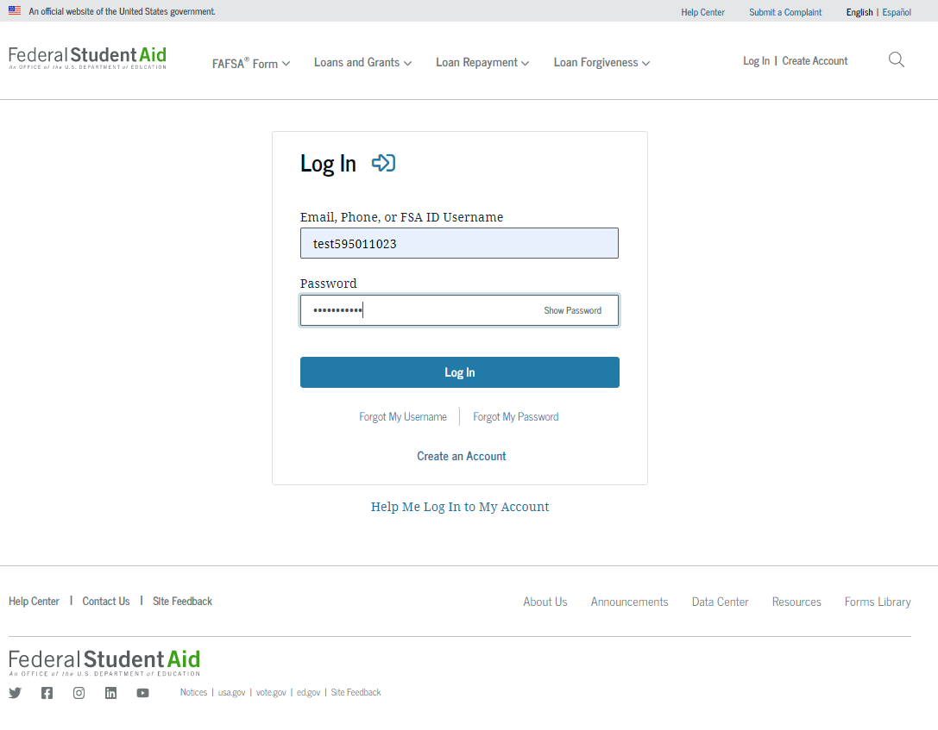
Dependent Student Log In
If the student selects "Start New Form" from the FAFSA® landing page and they are not logged in to StudentAid.gov, they are taken to the "Log In" page to enter their credentials. To access the FAFSA form, all students are required to have an FSA ID (StudentAid.gov account username and password). If the student doesn't have an FSA ID, they can select "Create an Account."

Slide 5
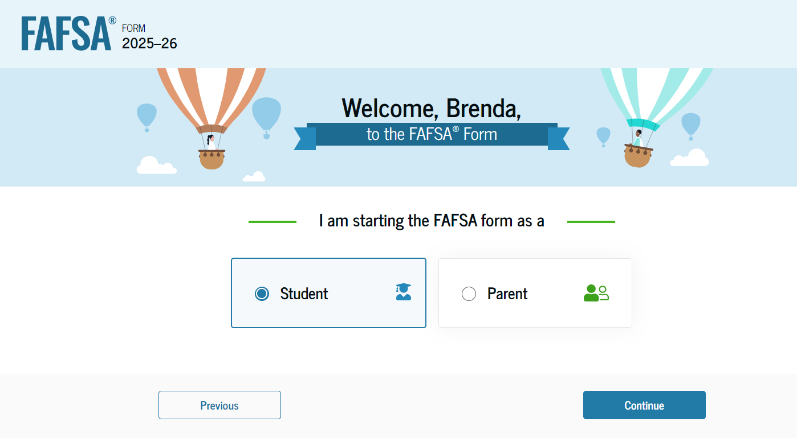
Dependent Student Roles
After logging in, the student can select the applicable role to fill out the FAFSA® form: "Student" or "Parent." The student selects "Student."

Slide 6
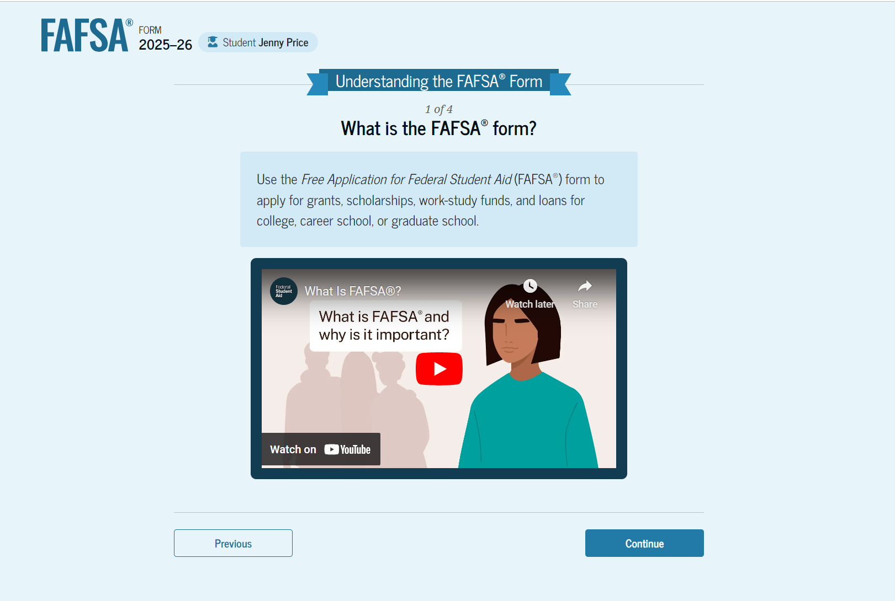
Student Onboarding (1 of 4)
When the student starts the 2025–26 FAFSA® form for the first time, they are taken through the FAFSA onboarding process. The first onboarding page provides an introduction of the FAFSA form and an accompanying video.

Slide 7
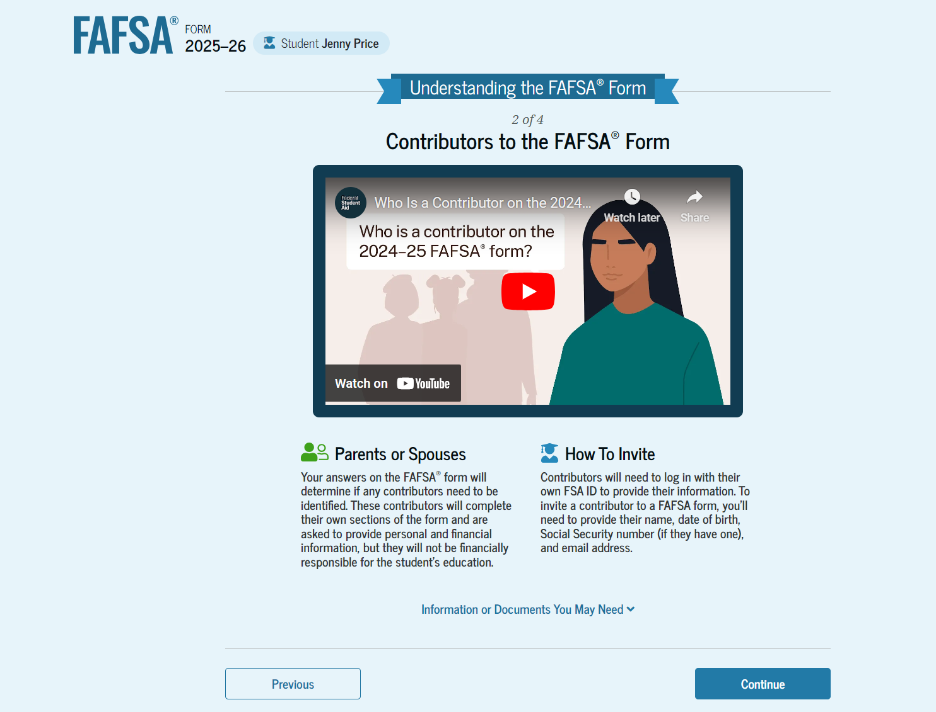
Dependent Student Onboarding (2 of 4)
The second FAFSA® onboarding page provides information about contributors that may be required to participate in the student’s FAFSA form, including an accompanying video that explains contributors, and information on how the student will invite them. Documents that may be needed to fill out the form are also included on this page.

Slide 8
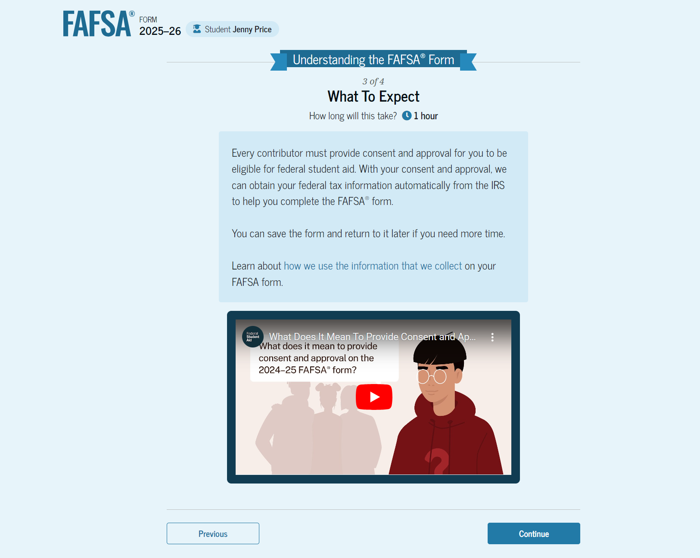
Dependent Student Onboarding (3 of 4)
The third FAFSA® onboarding page provides information about what the student can expect when completing their FAFSA form. This includes information about consent and approval, a time estimate for completing the form, and that they can save the form and return later if needed, along with an accompanying video.

Slide 9
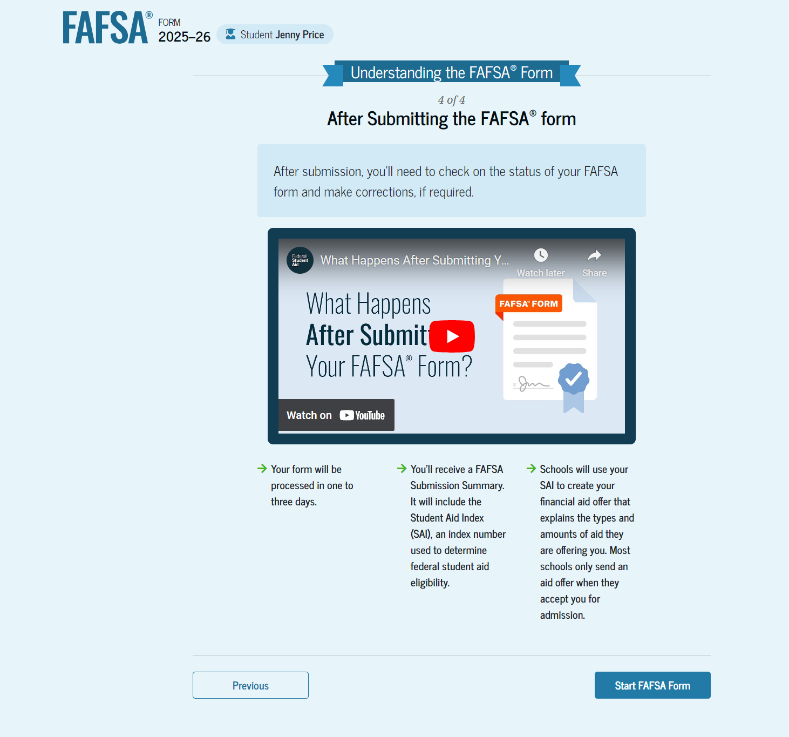
Dependent Student Onboarding (4 of 4)
The last FAFSA® onboarding page provides information about what to expect once the FAFSA form is completed, submitted, and processed. On this page, the student can select "Start FAFSA Form" to begin.

Slide 10
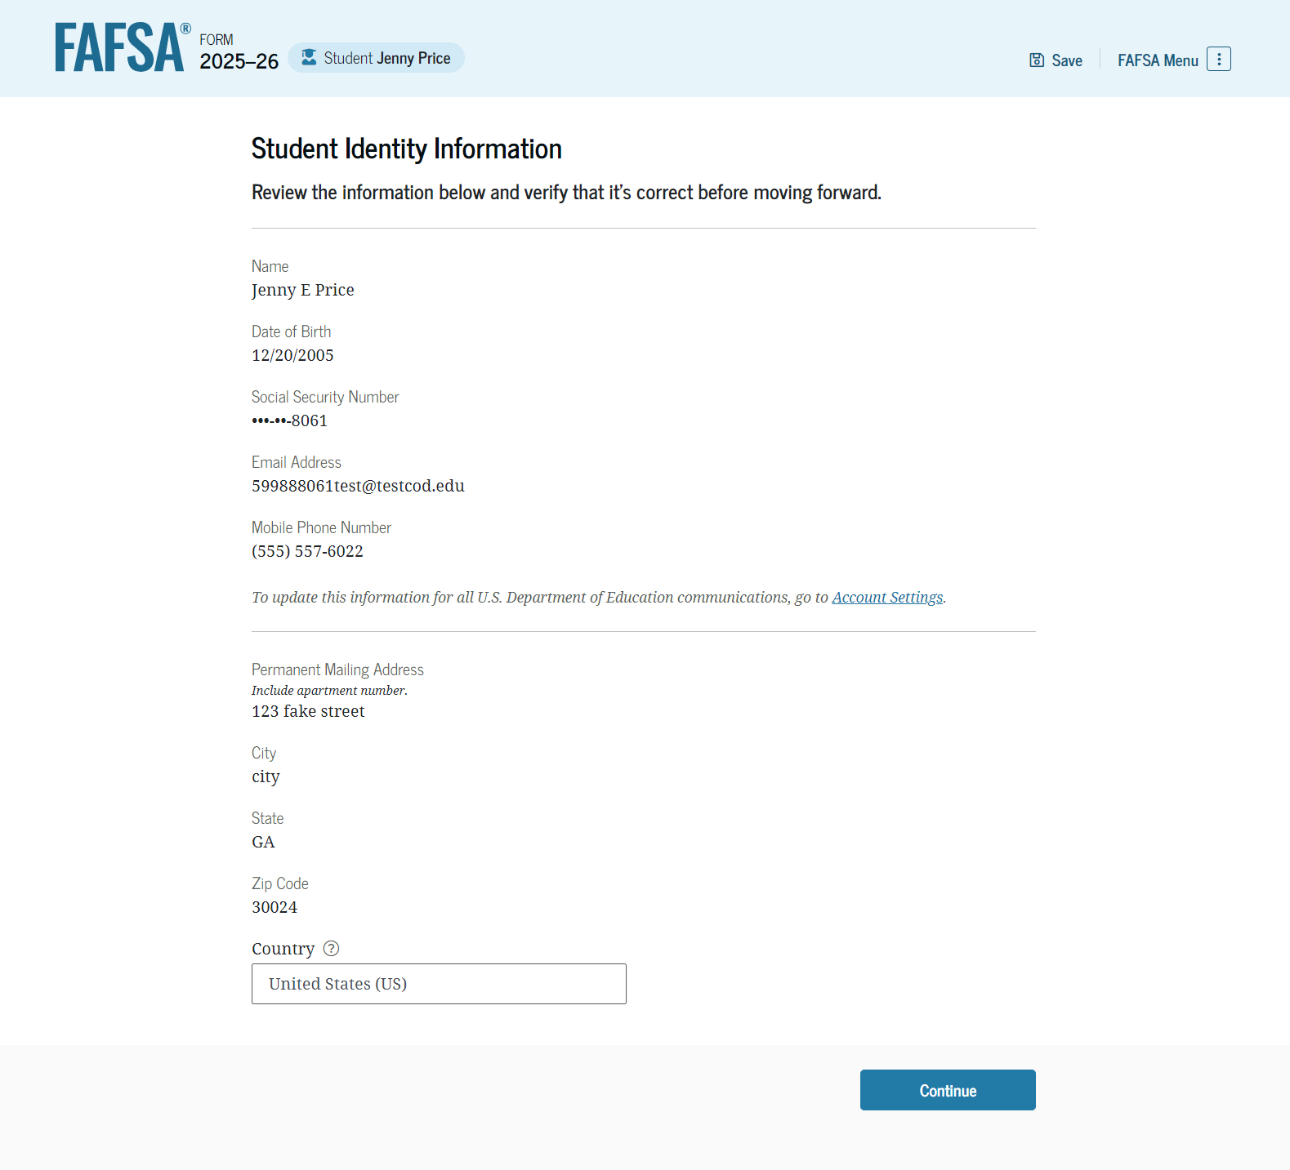
Dependent Student Identity Information
This is the first page within the student section. The student can verify that their personal information is correct. To update any of the personal information, the student must access their Account Settings on StudentAid.gov.

Slide 11
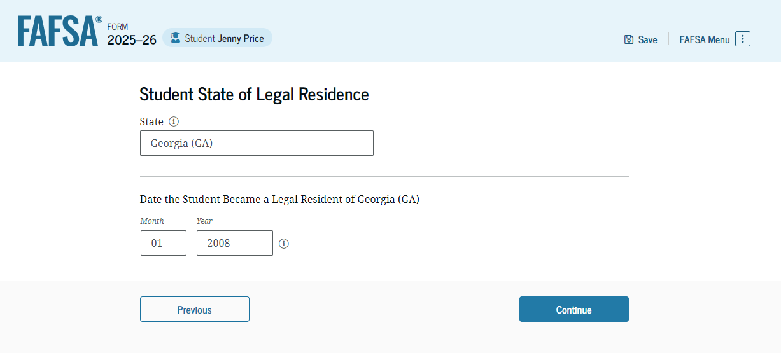
Dependent Student State of Legal Residence
The student is asked about their state of legal residence. The student selects the state from a drop-down box and provides the month and year when they became a legal resident.

Slide 12
Dependent Student Provides Consent and Approval
This page informs the student about consent, approval, and the use of their federal tax information. By providing consent and approval, the student’s federal tax information is transferred directly into the FAFSA® form from the IRS to help complete the "Student Financials" section.

Slide 13
Dependent Student Provides Consent and Approval (Continued)
This is a continuation of the consent and approval page. Frequently asked questions about consent and approval are also provided that the student can expand and collapse. The student selects "Approve" to provide consent and approval, and they are taken to the next page.

Slide 14
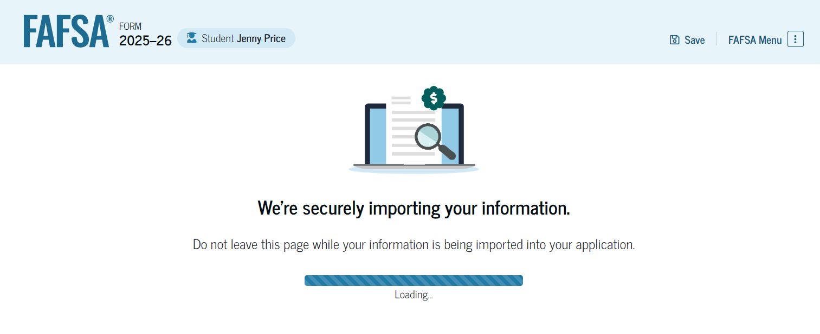
Dependent Student Imports IRS Information
This page imports the student’s federal tax information by directly transferring it into the FAFSA® form from the IRS to help complete the "Student Financials" section.

Slide 15
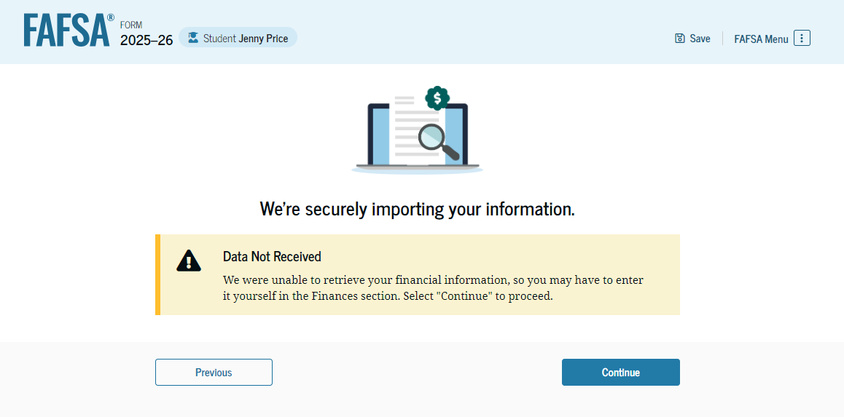
Dependent Student Imports IRS Information (Continued)
This page displays the results from the IRS import for the student. For this scenario, the student is starting a new FAFSA® form and there is no federal tax information available from the IRS.

Slide 16
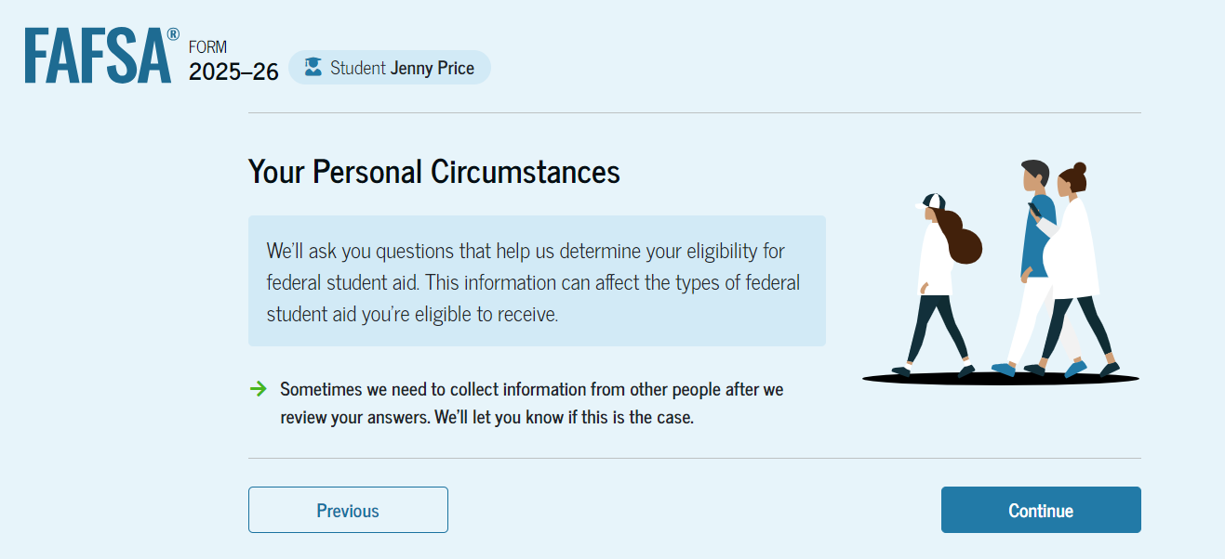
Dependent Student Personal Circumstances
This is the first page within the "Student Personal Circumstances" section. It provides an overview of the section.

Slide 17
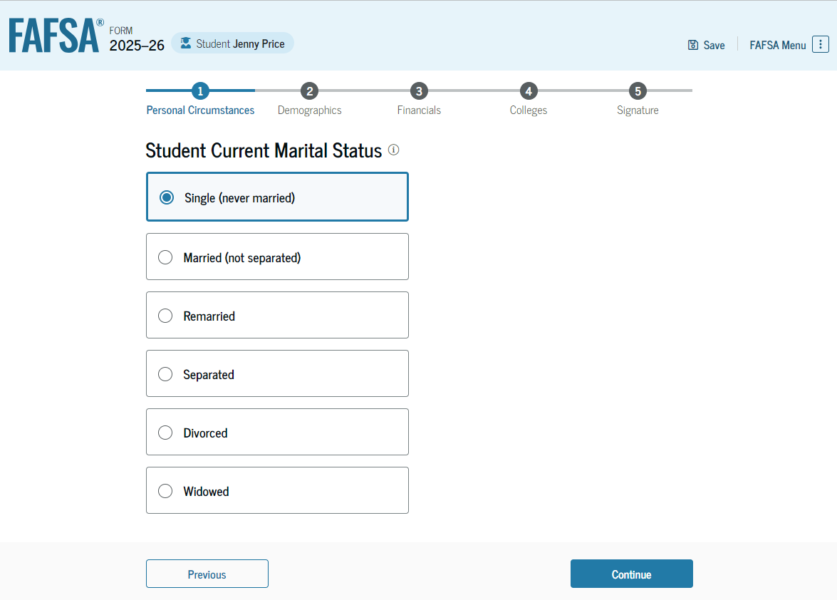
Dependent Student Marital Status
The student is asked about their marital status. The student selects the "Single (never married)" option.

Slide 18
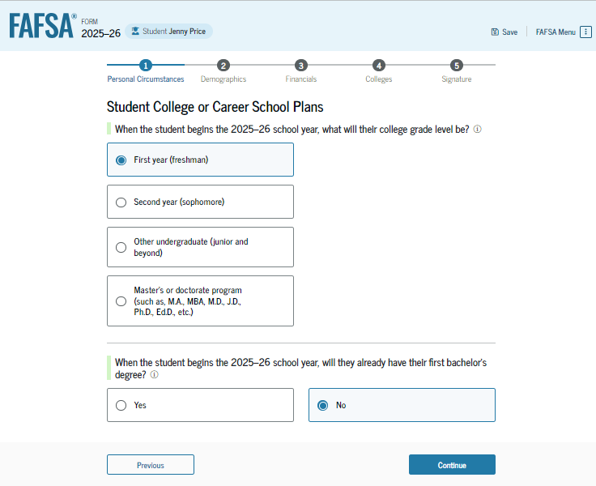
Dependent Student College or Career School Plans
The student is asked about their college grade level for the 2025–26 school year and if they will have their first bachelor’s degree. The student selects that they will be a "First year (freshman)" and that they will not have their first bachelor’s degree.

Slide 19
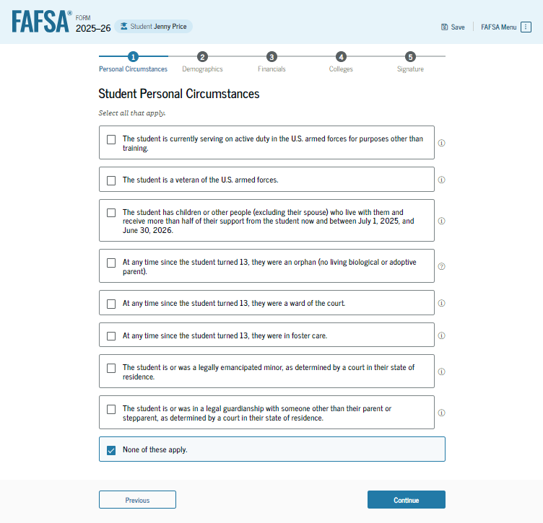
Dependent Student Personal Circumstances (Continued)
The student is asked if any of the listed personal circumstances apply to them. The student selects "None of these apply."

Slide 20
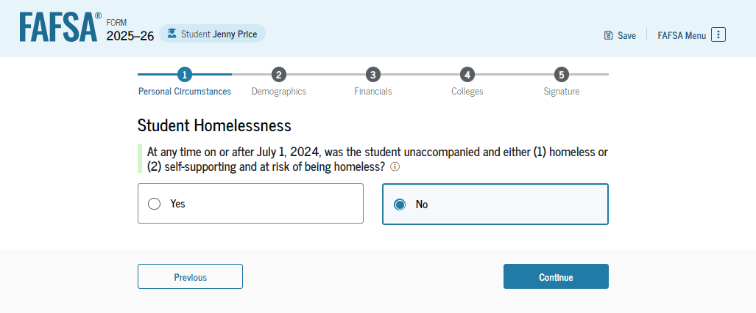
Dependent Student Homelessness
The student is asked if they were homeless or at risk of being homeless. The student selects "No."

Slide 21
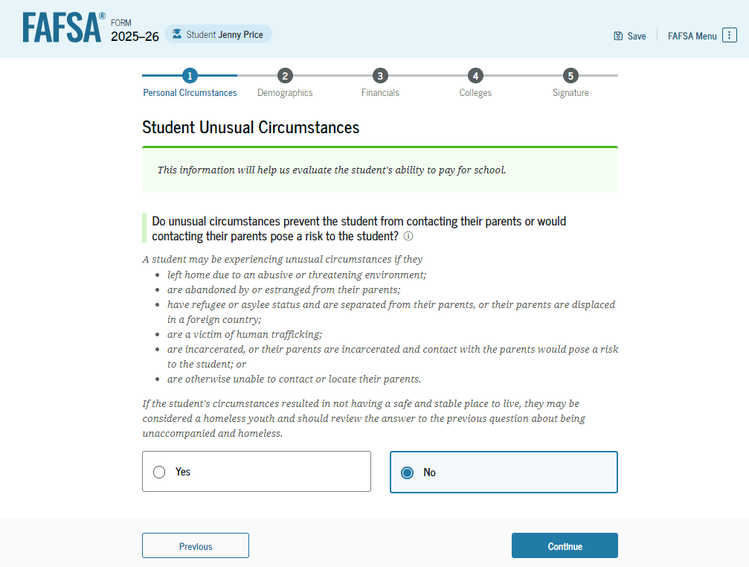
Dependent Student Unusual Circumstances
The student is asked if unusual circumstances prevent them from contacting their parent(s). The student selects "No."

Slide 22
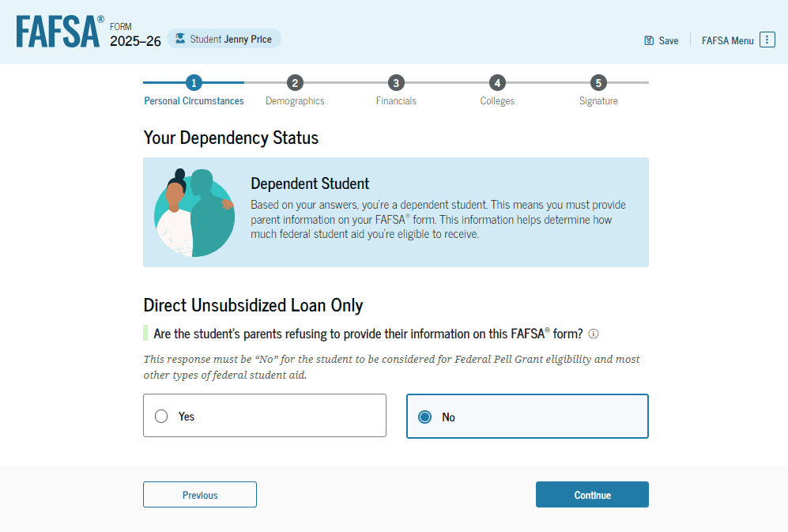
Student Dependency Status: Dependent Student
Based on the answers provided by the student, they are considered a dependent student. The student is asked if they want a financial aid administrator to determine their eligibility for a Direct Unsubsidized Loan only. This is an option if the student’s parents are unwilling to provide information. The student selects "No,“ and if the student had selected “Yes,” a modal would appear to warn them about missing out on other potential federal student aid.

Slide 23
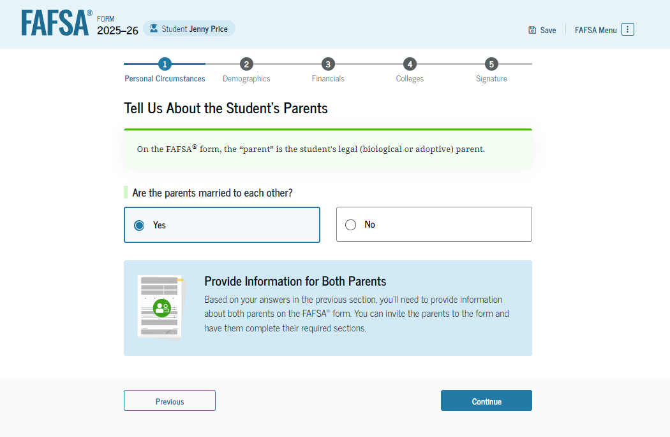
Dependent Student: Tell Us About Your Parents
As the student is considered dependent, they are asked to provide information about their parents. The FAFSA® form considers their “parent" to be their legal (biological or adoptive) parent. The student is asked if their parents are married. The student selects "Yes" and is instructed to provide information about both their parents on the FAFSA form.

Slide 24
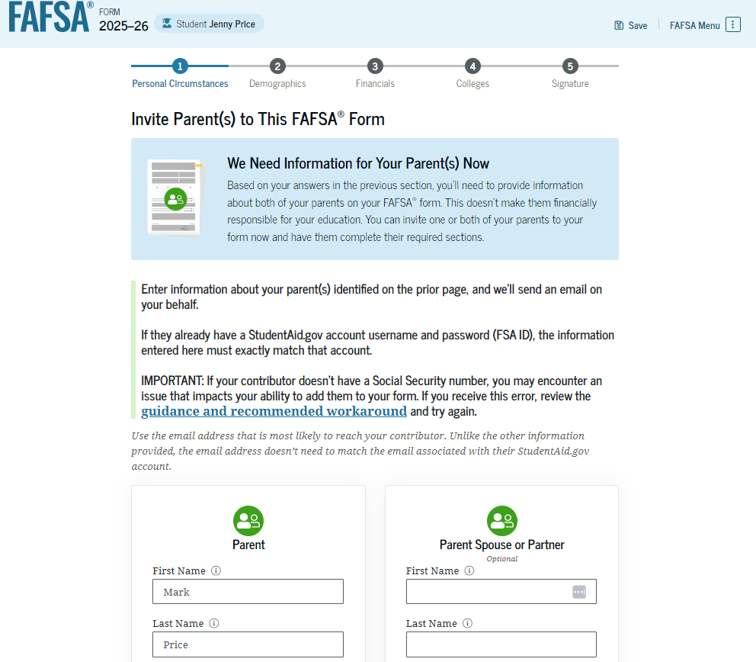
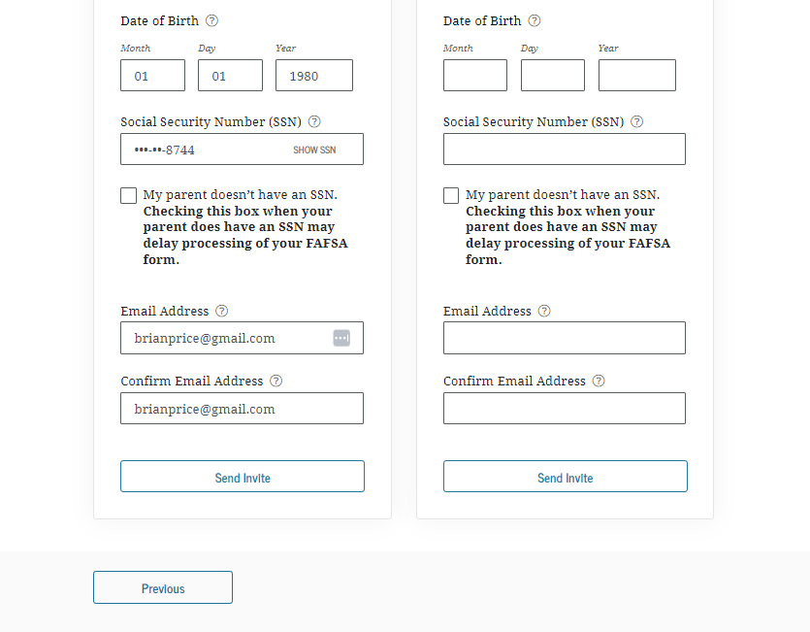
Dependent Student Invites Parents to FAFSA® Form
The student is asked to enter personal information about their parents in order to send them an invite to their FAFSA® form. In this scenario, the student invites one parent.

Slide 25
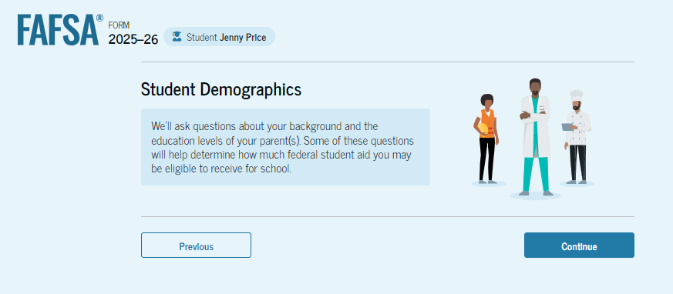
Introduction: Dependent Student Demographics
This is the first page within the "Student Demographics" section. It provides an overview of the section.

Slide 26
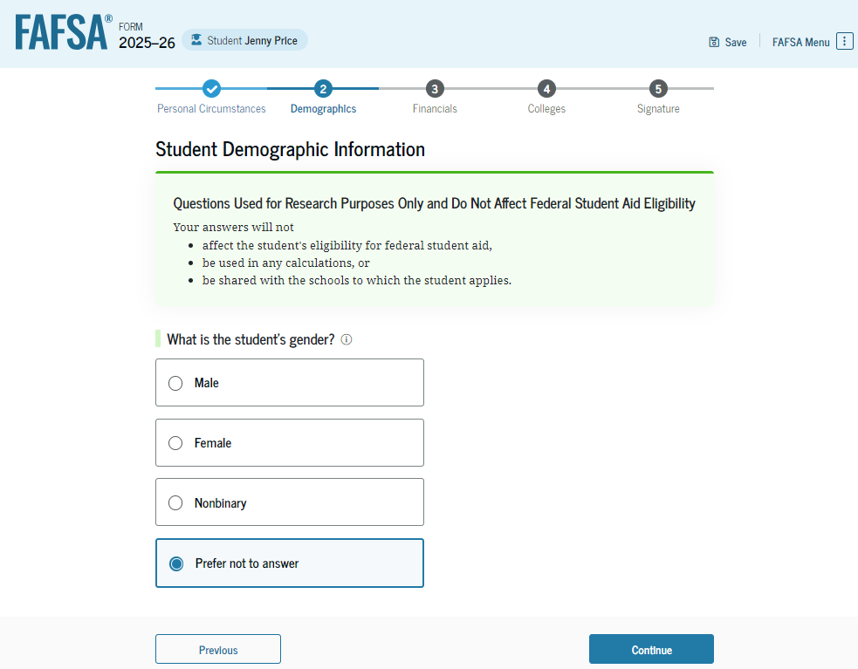
Dependent Student Demographic Information
The student is asked about their gender identity. The student selects “Prefer not to answer.”

Slide 27
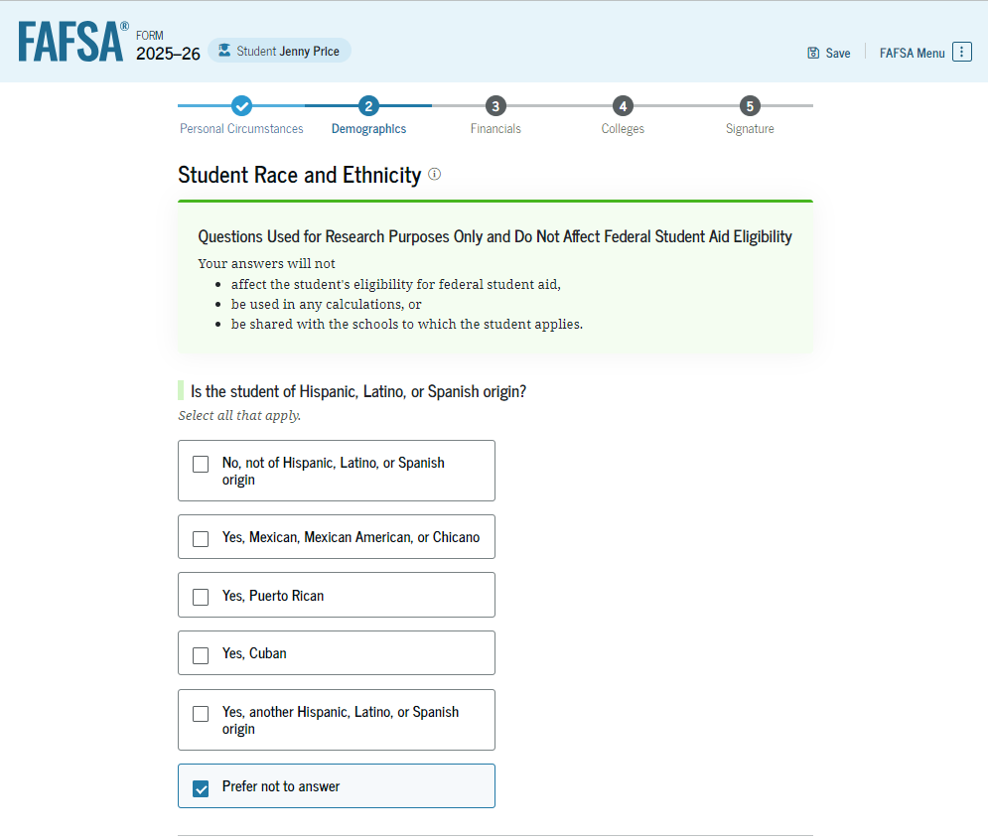
Dependent Student Race and Ethnicity
The student is asked if they are of Hispanic, Latino, or Spanish origin. The student selects the checkboxes that apply to them.

Slide 28
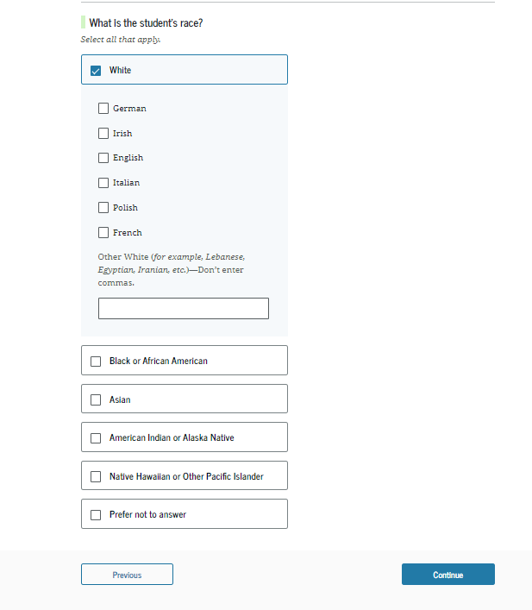
Dependent Student Race and Ethnicity (Continued)
This is a continuation of the student race and ethnicity page. The student is asked to identify their race. The student selects the checkboxes that apply to them.

Slide 29
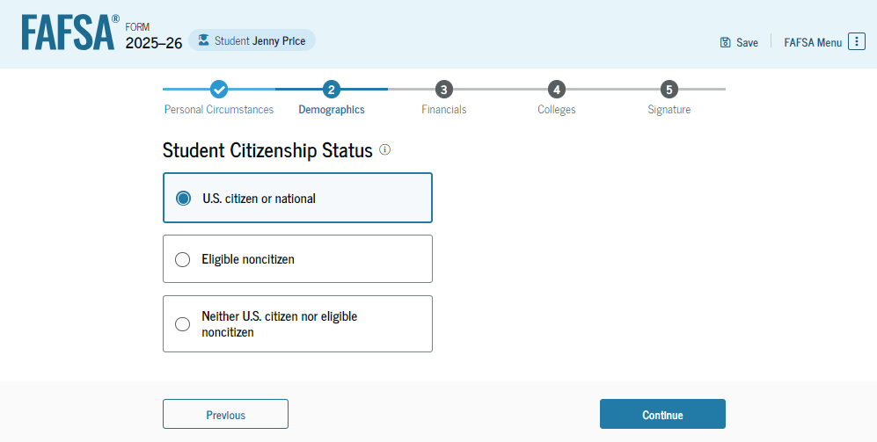
Dependent Student Citizenship Status
The student is asked about their citizenship status. The student selects the "U.S. citizen or national" option.

Slide 30
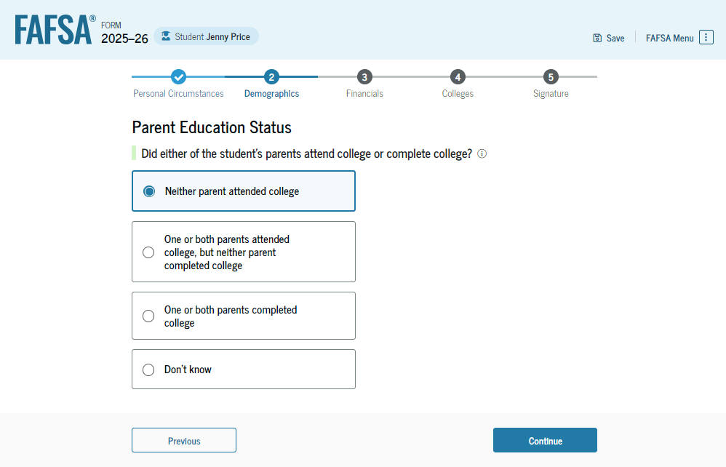
Dependent Student’s Parent Education Status
The student is asked about their parents’ education status. The student selects the "Neither parent attended college" option.

Slide 31
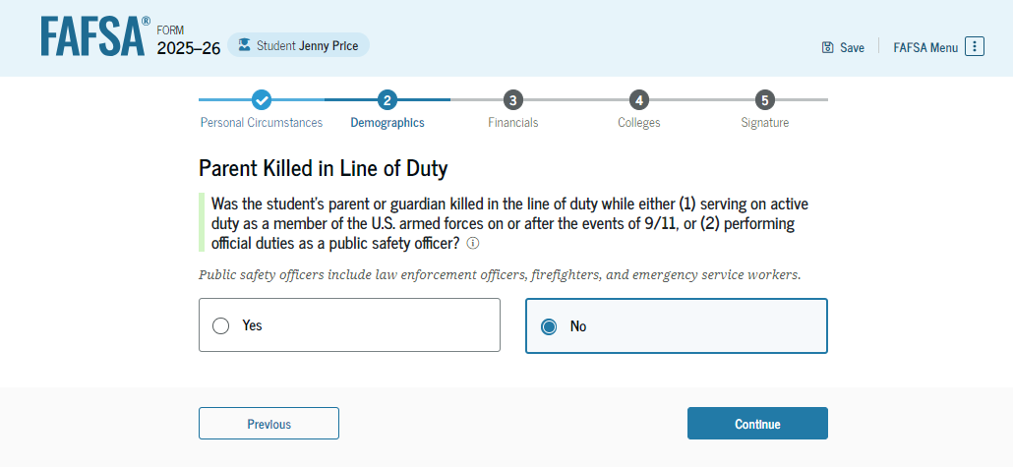
Dependent Student’s Parent Killed in Line of Duty
The student is asked if their parent was killed in the line of duty. The student selects the "No" option.

Slide 32
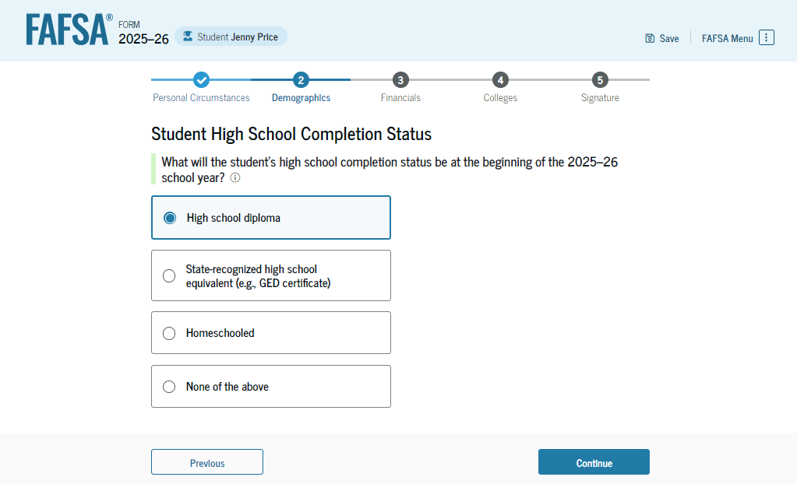
Dependent Student High School Completion Status
The student is asked about what their high school completion status will be when they start the 2025–26 school year. The student selects the "High school diploma" option.

Slide 33
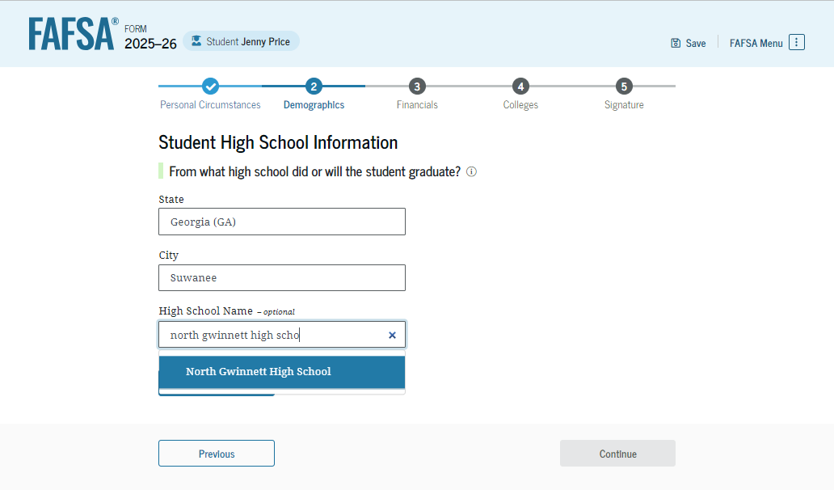
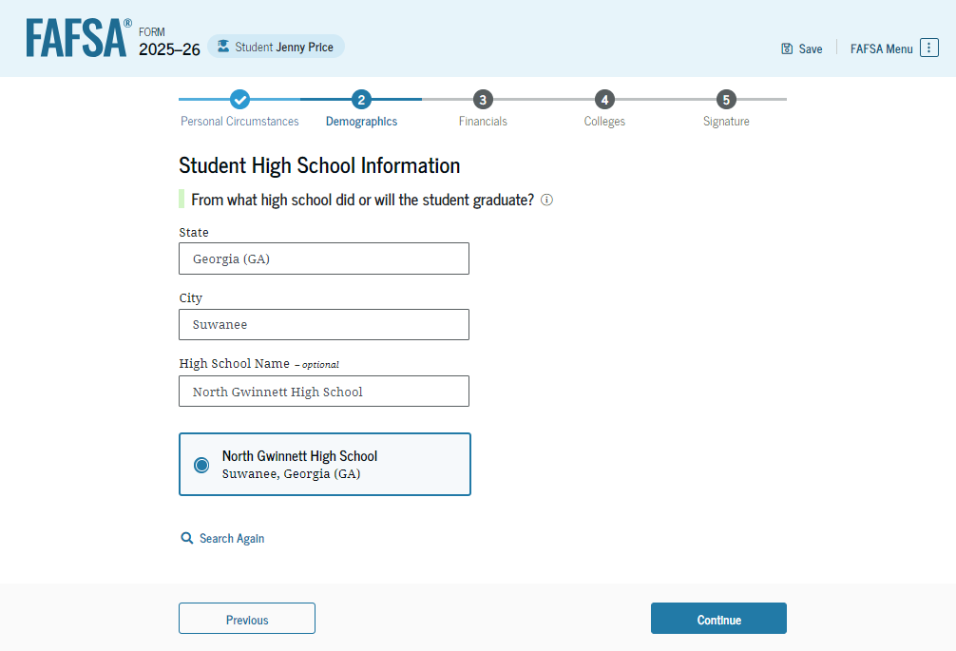
Dependent Student High School Information
The student is asked which high school they did or will graduate from. The student enters their high school’s state and city. After selecting "Search," they select the correct high school from the search results.

Slide 34
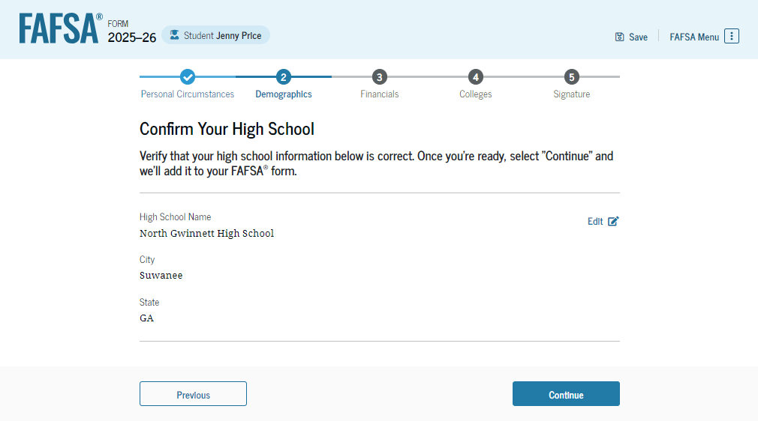
Dependent Student Confirms High School
The student has the option to edit the high school information presented on this page by selecting "Edit," which will return them to the high school information page. The student confirms their high school information and selects "Continue" to proceed to the next section.

Slide 35
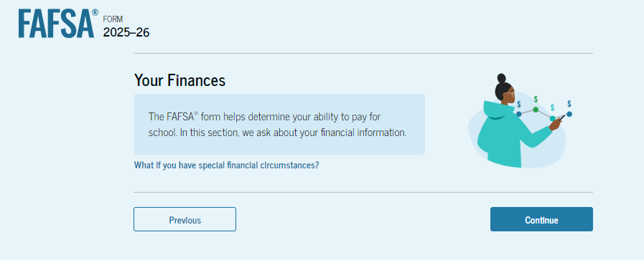
Introduction: Dependent Student Financials
This is the first page within the "Student Financials" section. It provides an overview of the section. The student can select the hyperlink if they want to learn about special financial circumstances.

Slide 36
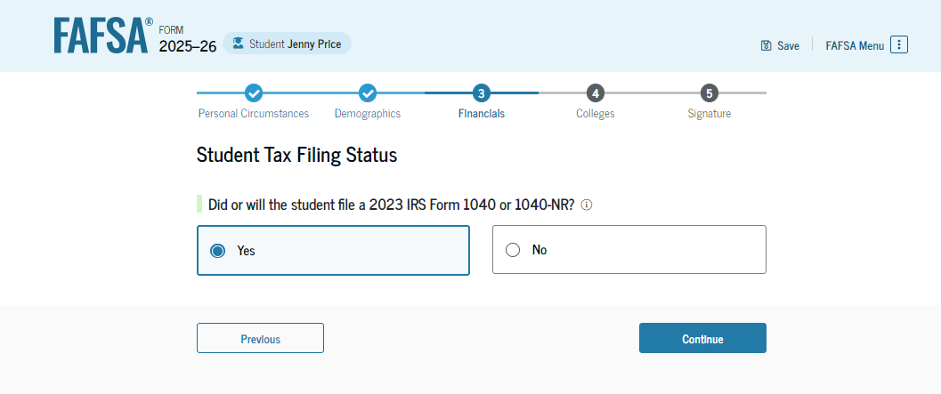
Dependent Student Tax Filing Status
The student is asked about their tax filing status. The student selects "Yes" to "Did or will the student file a 2023 IRS Form 1040 or 1040-NR?"

Slide 37
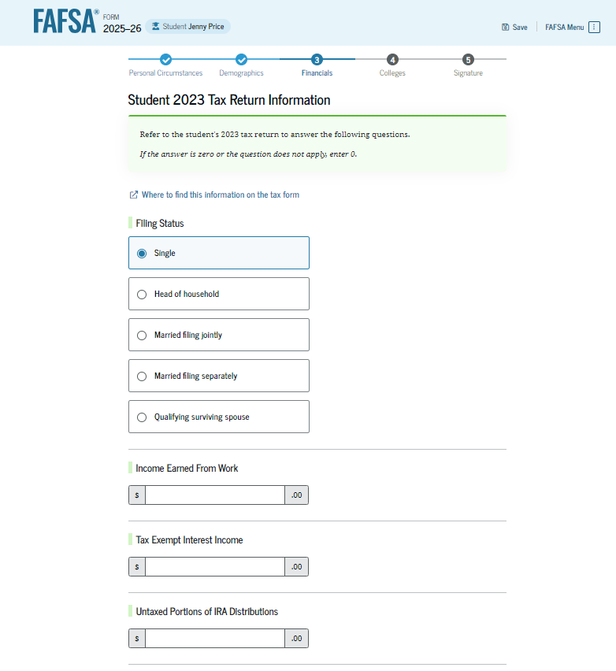
Dependent Student Tax Return Information
The student is asked about their 2023 tax return. The student selects "Single" as their filing status.

Slide 38
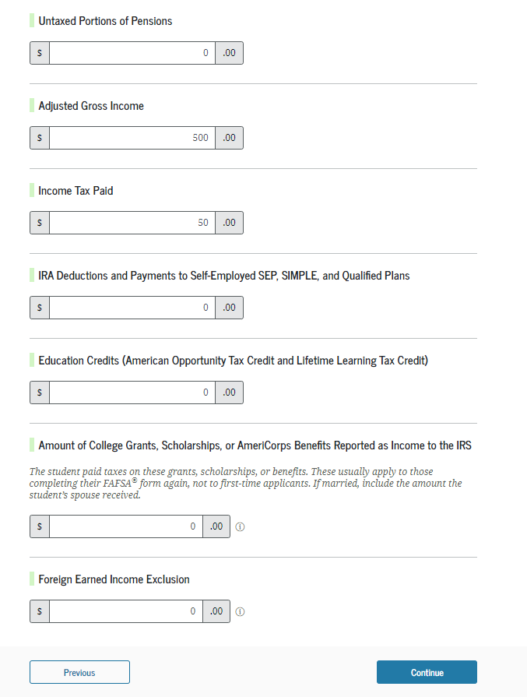
Dependent Student Tax Return Information (Continued)
The student is asked about their taxes, income, and other financial information. The student enters dollar amounts in the responses.

Slide 39
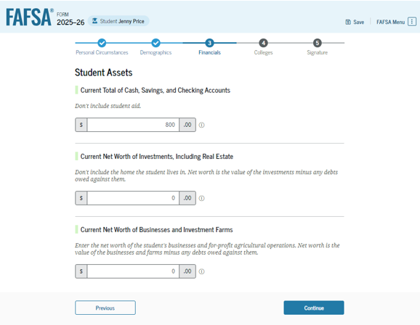
Dependent Student Assets
The student is asked about their assets. The student enters a response in each entry field.

Slide 40
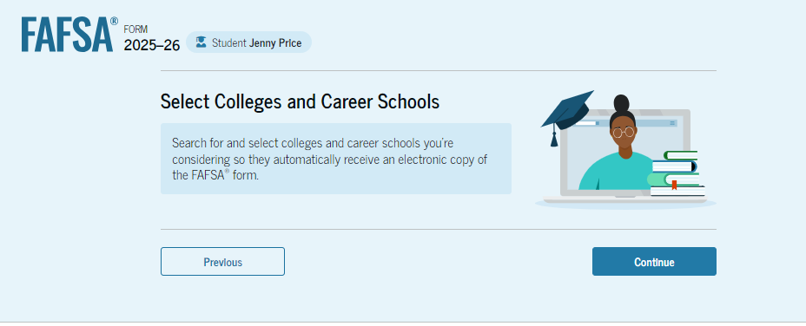
Introduction: Dependent Student Select Colleges
This is the first page in the "Select Colleges and Career Schools" section, which is the final part of the FAFSA® form’s student section to require information. It provides an overview of the section.

Slide 41
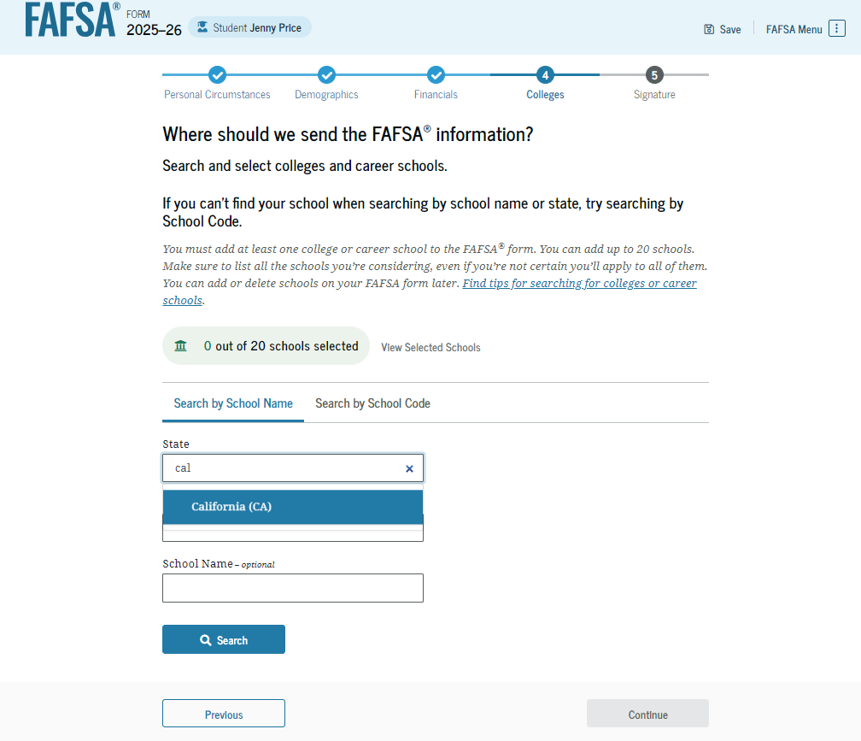
Dependent Student College Search
The student is asked to search for the colleges and/or career schools they would like to receive their FAFSA® information. The student searches for a school by entering a state, city, and/or school name and selecting "Search." If the student can’t find a school searching by school name or state, they can search by school code. The student must add at least one college or career school to continue.

Slide 42
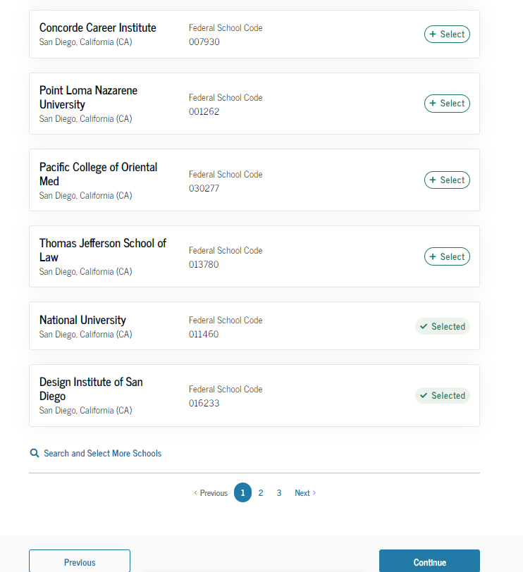
Dependent Student College Search (Continued 1 of 2)
After entering a school’s state, city, and/or school name and selecting "Search," the student selects the correct school(s) from the search results. Students can send their FAFSA® information to a maximum of 20 schools.

Slide 43
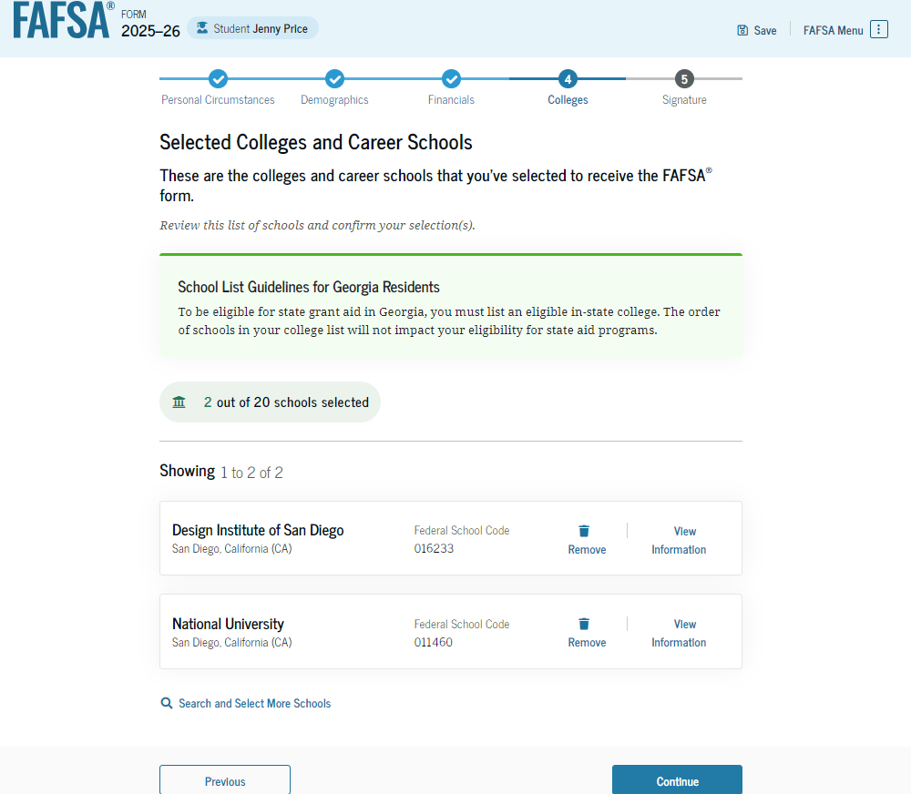
Dependent Student College Search (Continued 2 of 2)
After the student selects the correct school(s) from the search results, they can review the school(s) they chose before continuing.

Slide 44
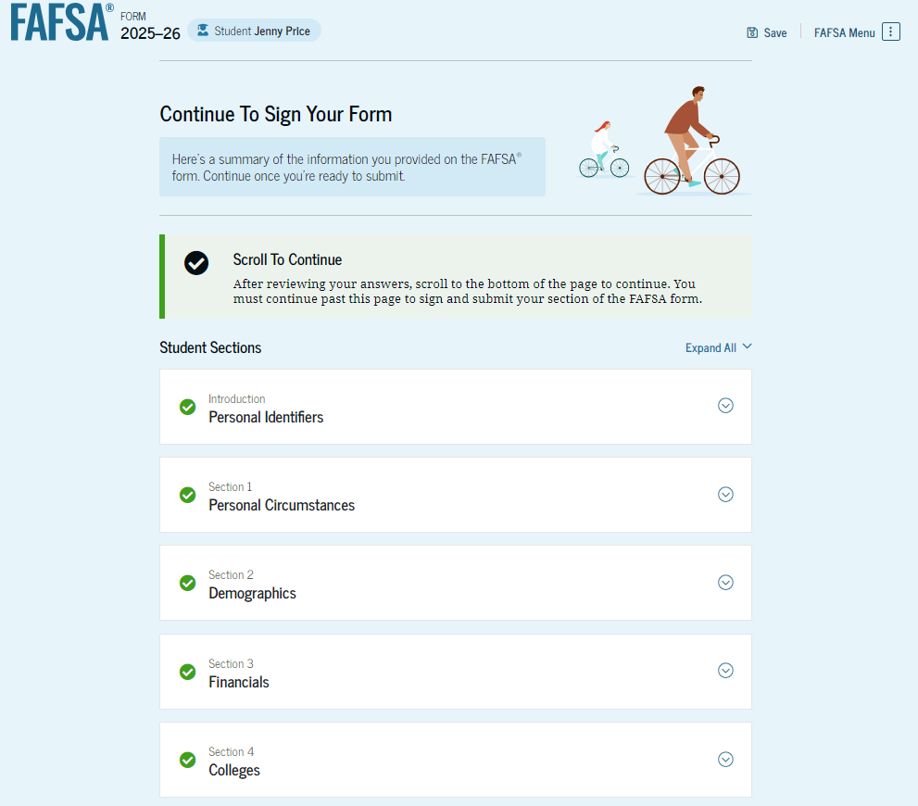
Dependent Student Review Page
The review page displays the responses that the student has provided in the FAFSA® form. The student can view all their responses by selecting "Expand All" or expand each section individually. To edit a response, the student can select the question’s hyperlink to be taken to the corresponding page.

Slide 45
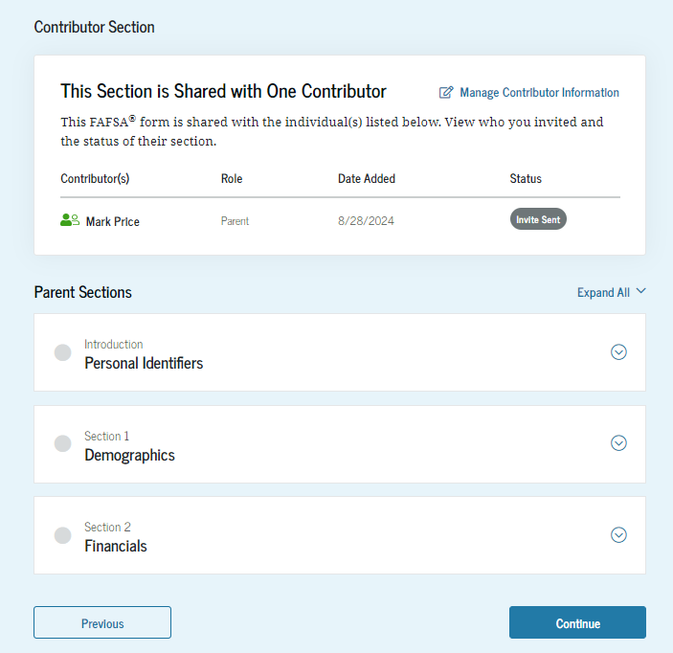
Dependent Student Review Page (Continued)
This is a continuation of the student review page. Since the student invited their parent to their form, they see the parent contributor section and the status of their parent’s invite.

Slide 46
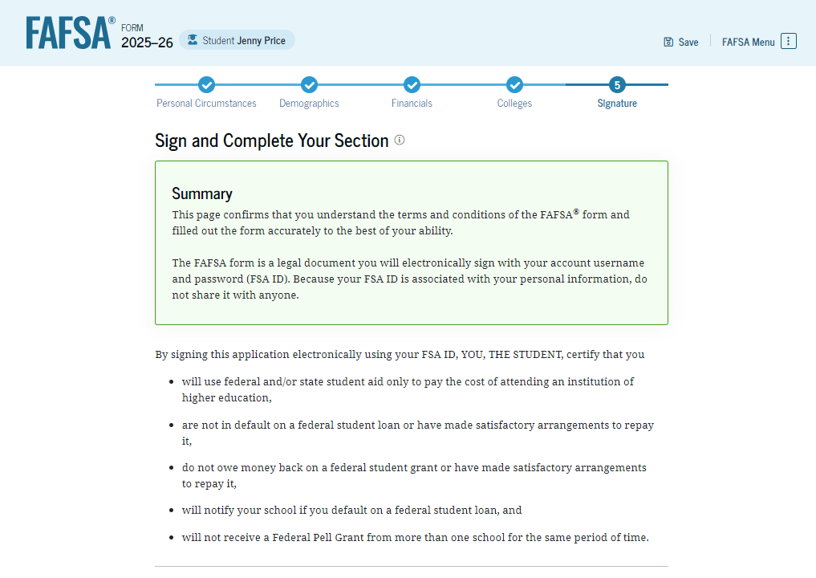
Dependent Student Signature
On this page, the student reviews the terms and conditions of the FAFSA® form and what they’ll agree to if they sign the form.

Slide 47
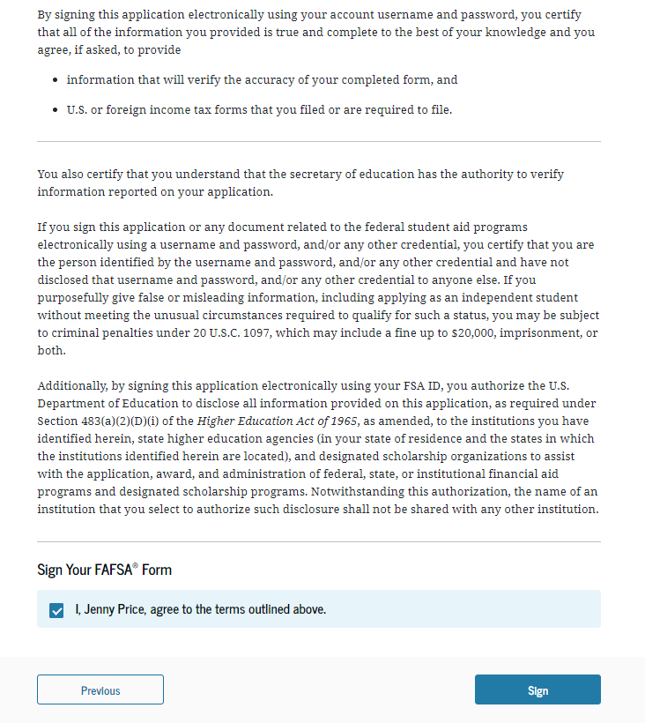
Dependent Student Signature (Continued)
This is a continuation of the student signature page. After agreeing to the terms and conditions of the FAFSA® form and signing, the student is able to submit their section of the FAFSA form. Since parent information has not been provided, the FAFSA form is not considered complete and can’t be processed yet.

Slide 48
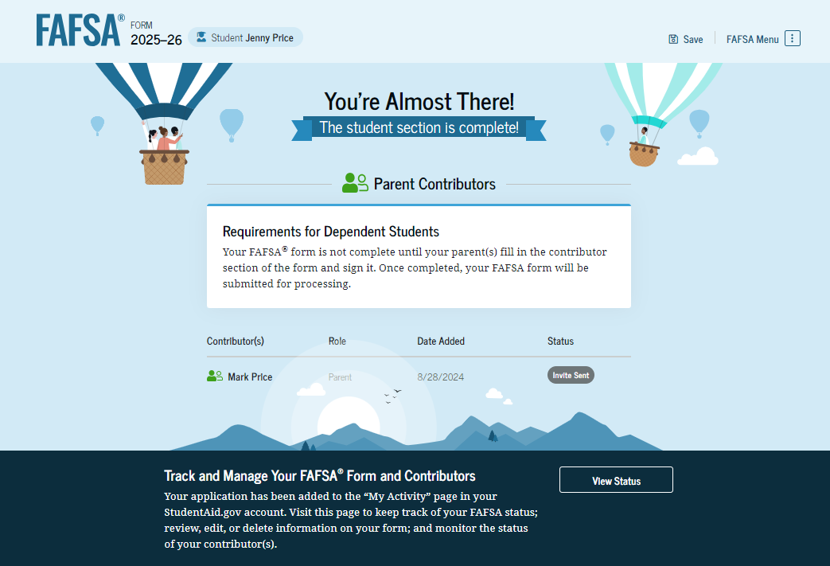
Dependent Student Section Complete
Upon signing the student section, the student is presented “The student section is complete!” page. The student is reminded that their FAFSA® form is not completed and can’t be submitted until the parent completes the contributor section of the form and signs it. This page also displays next steps the student can take, including tracking and managing their form.

Slide 49
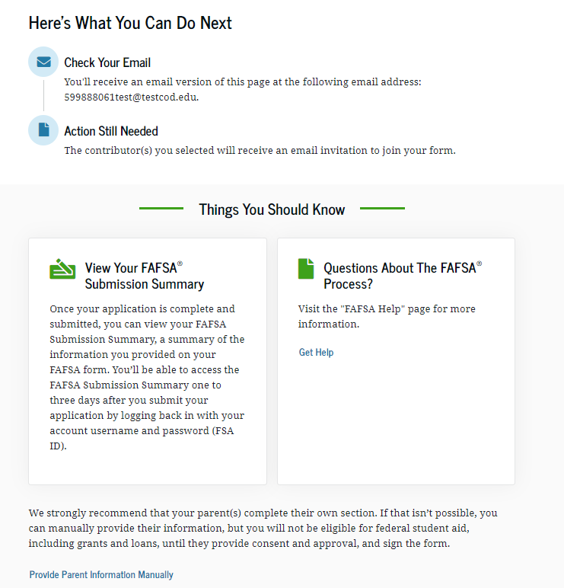
Dependent Student Section Complete (Continued)
This is a continuation of the student section complete page. This page displays information for the student about next steps, including checking their email and a reminder that their FAFSA® form is not completed and can’t be submitted until the parent completes the contributor section of the form and signs it. Next, in this scenario, the student’s invited parent will enter the FAFSA form and complete the parent section.

Slide 50
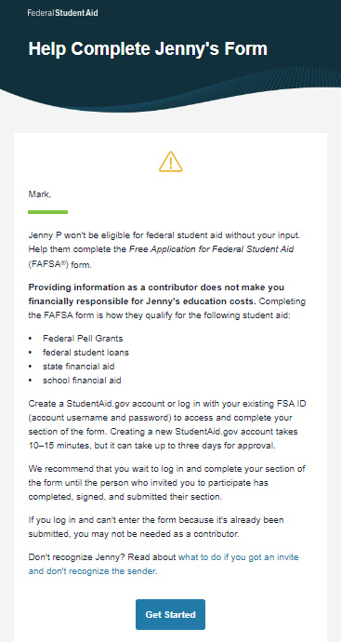
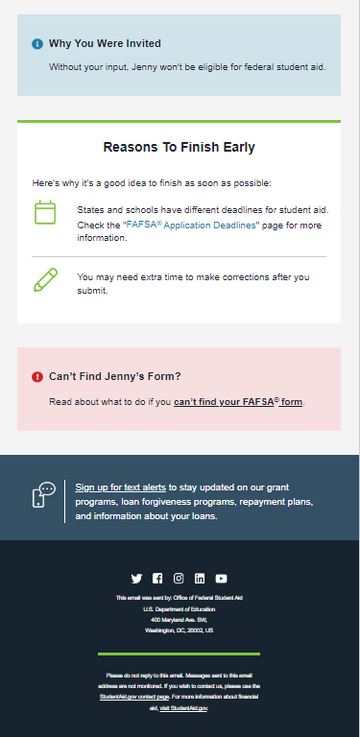
Dependent Student’s Parent Email
This is NOT a view within StudentAid.gov or the FAFSA® form. This view demonstrates a parent opening the FAFSA invitation from their email. The parent selects "Get Started" and is taken to StudentAid.gov.

Slide 51
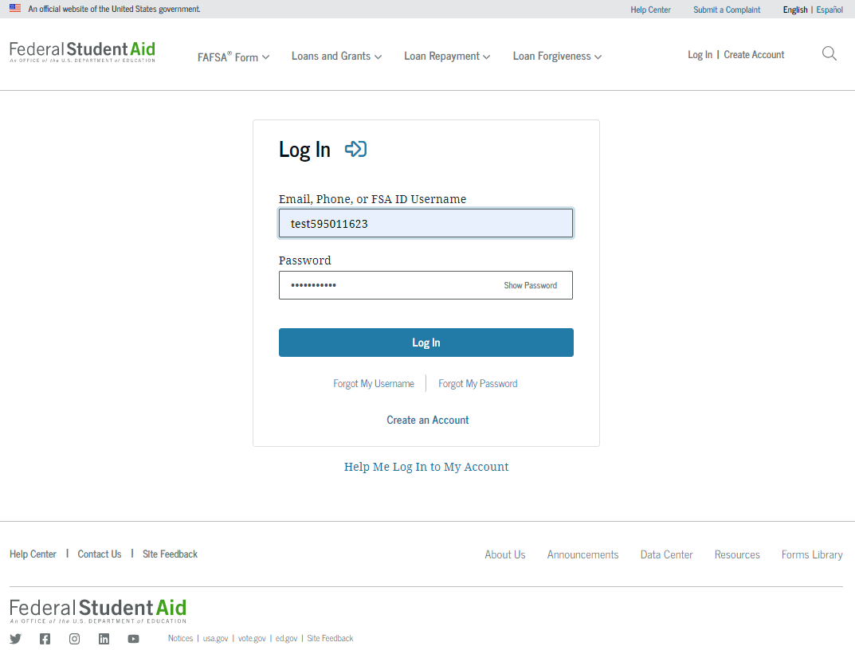
Dependent Student’s Parent Log In
The parent is taken from their email to the "Log In" page to enter their credentials. To access the FAFSA® form, all users are required to have an FSA ID (StudentAid.gov account username and password). If the parent doesn't have an FSA ID, they can select "Create an Account."

Slide 52
Parent Status Center – My Activity
After successfully logging in, the parent is taken to their "My Activity" section. The parent sees an invitation to be a contributor on the student’s FAFSA® form.

Slide 53
Parent Status Center – My Activity (Continued)
When the parent selects "Accept Invitation," a pop-up window appears to remind the parent that their personal information is needed to fill out the student’s FAFSA® form. The parent selects "Continue" to agree to sharing their information and enters the FAFSA form.

Slide 54
Dependent Student’s Parent Onboarding (1 of 4)
When the parent enters a 2025–26 FAFSA® form for the first time, they are taken through the FAFSA onboarding process. The first onboarding page provides an introduction of the FAFSA form and an accompanying video.

Slide 55
Dependent Student’s Parent Onboarding (2 of 4)
The second FAFSA® onboarding page provides information about contributors that may be required to participate in the student’s FAFSA form, including an accompanying video that explains contributors, and information on how the parent will invite them. Documents that may be needed to fill out the form are also included on this page.

Slide 56
Dependent Student’s Parent Onboarding (3 of 4)
The third FAFSA® onboarding page provides information about what the parent can expect when completing the student’s FAFSA form. This includes information about consent and approval, a time estimate to complete the form, and that they can save the form and return later if needed, along with an accompanying video.

Slide 57
Dependent Student’s Parent Onboarding (4 of 4)
The last onboarding page provides information about what to expect once the FAFSA® form is completed, submitted, and processed. On this page, the parent selects "Start FAFSA Form" to begin the parent section.

Slide 58
Dependent Student’s Parent Identity Information
This is the first page within the parent section. The parent can verify that their personal information is correct. To update any of the personal information, the parent must access their Account Settings on StudentAid.gov.

Slide 59
Dependent Student’s Parent Identity Information (Continued)
This is a continuation of the first page within the parent section. The parent can verify their mailing address on this part of the page. To update this information, the parent must access their Account Settings on StudentAid.gov.

Slide 60
Dependent Student’s Parent Provides Consent and Approval
This page informs the parent about consent, approval, and the use of their federal tax information. By providing consent and approval, the parent’s federal tax information is transferred directly into the FAFSA® form from the IRS to help complete the "Parent Financials" section.

Slide 61
Dependent Student’s Parent Provides Consent and Approval (Continued)
This is a continuation of the consent and approval page. Frequently asked questions about consent and approval are also provided that the parent can expand and collapse. The parent selects "Approve" to provide consent and approval, and they are taken to the next page.

Slide 62
Dependent Student’s Parent Imports IRS Information
This page imports the parent’s federal tax information by directly transferring it into the FAFSA® form from the IRS to help complete the “Parent Financials" section.

Slide 63
Dependent Student’s Parent Imports IRS Information (Continued)
This page displays the results from the IRS import for the parent. For this scenario, the parent is contributing to a new FAFSA® form and there is no federal tax information available from the IRS.

Slide 64
Introduction: Dependent Student’s Parent Demographics
This is the first page in the "Parent Demographics" section. It provides an overview of the section.

Slide 65
Dependent Student’s Parent Current Marital Status
The parent is asked about their current marital status. They select the "Married (not separated)" option.

Slide 66
Dependent Student’s Parent State of Legal Residence
The parent is asked about their state of legal residence. The parent selects the state from a drop-down box and provides the month and year when they became a legal resident.

Slide 67
Introduction: Dependent Student’s Parent Finances
This is the first page within the "Parent Financials" section. It provides an overview of the section.

Slide 68
Dependent Student’s Parent Federal Benefits Received
This page asks the parent if they or anyone in their family has received federal benefits. The parent selects "None of these apply."

Slide 69
Dependent Student’s Parent Tax Filing Status
This page asks the parent about their tax filing status. The parent selects "Yes" to "Did or will the parent file a 2023 IRS Form 1040 or 1040-NR?" and “Yes” to “Did or will the parent file a 2023 joint tax return with their current spouse?”

Slide 70
Dependent Student’s Parent Family Size
This page displays the family size for the student. The parent has the option to enter the number of children or other dependents who live with the parent and will receive more than half of their support from the parent between July 1, 2025, and June 30, 2026.

Slide 71
Dependent Student’s Parent Number in College
This page asks the parent how many people in the family will be in college between July 1, 2025, and June 30, 2026. The parent enters a response into the entry field.

Slide 72
Dependent Student’s Parent Tax Return Information
The parent is asked questions about their 2023 tax return. The parent enters a response in each entry field.

Slide 73
Dependent Student’s Parent Assets
The parent is asked about their assets. The parent enters a response in each entry field.

Slide 74
Dependent Student’s Other Parent Information
The parent is asked to provide information about their spouse or partner. In this example, the other parent does not need to contribute to the student’s FAFSA® form because the parents filed taxes jointly. After providing the other parent’s information, all required parent information will be complete.

Slide 75
Dependent Student’s Parent Review Page
The review page displays the responses that the parent has provided in the FAFSA® form. The parent can only view responses within the parent section of the student’s FAFSA form. The parent can view all their responses by selecting "Expand All" or expand each section individually. To edit a response, the parent can select the question’s hyperlink to be taken to the corresponding page.

Slide 76
Dependent Student’s Parent Signature
On this page, the parent acknowledges the terms and conditions of the FAFSA® form and signs their section. Since all required sections are complete, the parent can both sign and submit the student’s FAFSA form.

Slide 77
Dependent Student FAFSA® Confirmation
Upon submitting the student’s FAFSA® form, the parent is presented an abbreviated confirmation page. This page displays information about tracking the student’s FAFSA form and next steps. The student will receive an email with the full, detailed confirmation. With the student and parent sections completed and signed, the FAFSA form is now considered complete and submitted for processing.

Slide 78
Parent Starts and Submits a FAFSA® Form Without Student Consent or Signature

Slide 79
Parent FAFSA® Landing Page
This is the main FAFSA® form landing page. On this page, students and parents are directed to "Start New Form" or “Edit Existing Forms." For this section of the presentation, the parent is beginning a new application on behalf of their child.

Slide 80
Parent Log In
If the parent selects "Start New Form" from the FAFSA® landing page and they are not logged in to StudentAid.gov, they are taken to the "Log In" page to enter their credentials. To access the FAFSA form, all parents are required to have an FSA ID (account username and password). If the parent doesn't have an FSA ID, they can select "Create an Account."​

Slide 81
Parent Roles
After logging in, the parent selects the applicable role to fill out the FAFSA® form: "Parent."

Slide 82
Parent’s Student Information
The parent is asked to provide the student’s information. Since the student has not started a FAFSA® form yet, they will receive an email notifying them that a FAFSA form was started on their behalf. The student can then enter the form to provide consent, sign the form, and make any needed corrections.

Slide 83
Parent Onboarding (1 of 4)
When the parent starts the 2025–26 FAFSA® form for the first time, they are taken through the FAFSA onboarding process. The first onboarding page provides an introduction of the FAFSA form and an accompanying video.

Slide 84
Parent Onboarding (2 of 4)
The second FAFSA® onboarding page provides information about contributors that may be required to participate in the student’s FAFSA form, including an accompanying video that explains contributors, and information on how the parent will invite them. Documents that may be needed to fill out the form are also included on this page within a drop-down menu and may include tax returns; record of child support received; current balances of cash, savings, and checking accounts; and net worth of investments, businesses, and farms.

Slide 85
Parent Onboarding (3 of 4)
The third FAFSA® onboarding page provides information about what the parent can expect when completing the student’s FAFSA form. This includes information about consent and approval, a time estimate to complete the form, and that they can save the form and return later if needed, along with an accompanying video.

Slide 86
Parent Onboarding (4 of 4)
The final FAFSA® onboarding page provides information about what to expect once the FAFSA form is completed, submitted, and processed. On this page, the parent can select "Start FAFSA Form" to begin.

Slide 87
Parent’s Student Identity Information
After starting the FAFSA® form, the parent sees the first page within the parent section. The parent can verify that the student’s personal information is correct. To update any of the personal information, the student must access their Account Settings on StudentAid.gov. The parent will not be able to update the student’s information on this page.

Slide 88
Parent’s Student Identity Information (Continued)
This is a continuation of the "Parent Identity Information" page. The parent can verify that the student’s personal information is correct.

Slide 89
Parent’s Student State of Legal Residence
The parent is asked about the student’s state of legal residence. The parent selects the state from a drop-down box and provides the month and year when the student became a legal resident.

Slide 90
Introduction: Parent’s Student Personal Circumstances
This is the first page within the "Student Personal Circumstances" section. It provides an overview of the section.

Slide 91
Parent’s Student Marital Status
The parent is asked about the student’s marital status. The parent selects the "Single (never married)" option.

Slide 92
Parent’s Student College or Career School Plans
The parent is asked about the student’s college grade level for the 2025–26 school year and if the student will have their first bachelor’s degree. The parent selects that the student will be a "First year (freshman)" and that they will not have their first bachelor’s degree.

Slide 93
Parent’s Student Personal Circumstances
The parent is asked if any of the listed personal circumstances apply to the student. The parent selects "None of these apply."

Slide 94
Parent’s Student Homelessness
The parent is asked if the student was unaccompanied and either homeless or at risk of being homeless. The parent selects "No."

Slide 95
Parent’s Student Unusual Circumstances
The parent is asked if unusual circumstances prevent the student from contacting their parent(s). The parent selects "No."

Slide 96
Parent’s Student Dependency Status: Dependent Student
Based on the answers provided by the parent, the student is considered a dependent student. The parent is asked if they want a financial aid administrator to determine the student’s eligibility for a Direct Unsubsidized Loan only. This is an option if they are unwilling to provide their information. The parent selects "No."

Slide 97
Parent Identity Information
This is the first page within the parent section. The parent can verify that their personal information is correct. To update any of the personal information, the parent must access their Account Settings on StudentAid.gov.

Slide 98
Parent Identity Information (Continued)
This is a continuation of the first page within the parent section. The parent can verify their mailing address on this part of the page. To update this information, the parent must access their Account Settings on StudentAid.gov.

Slide 99
Parent Provides Consent and Approval
This page informs the parent about consent, approval, and the use of their federal tax information. By providing consent and approval, the parent’s federal tax information is transferred directly into the FAFSA® form from the IRS to help complete the "Parent Financials" section.

Slide 100
Parent Provides Consent and Approval (Continued)
This is a continuation of the consent and approval page. Frequently asked questions about consent and approval are also provided that the parent can expand and collapse. The parent selects "Approve" to provide consent and approval, and they are taken to the next page.

Slide 101
Parent Imports IRS Information
This page imports the parent’s federal tax information by directly transferring it into the FAFSA® form from the IRS to help complete the “Parent Financials" section.

Slide 102
Parent Imports IRS Information (Continued)
This page displays the results from the IRS import for the parent. For this scenario, the parent is starting a new FAFSA and there is no federal tax information available from the IRS.

Slide 103
Introduction: Parent Demographics
This is the first page in the "Parent Demographics" section. It provides an overview of the section.

Slide 104
Parent Current Marital Status
The parent is asked about their current marital status. They select the "Single (never married)" option.

Slide 105
Parent State of Legal Residence
The parent is asked about their state of legal residence. The parent selects the state from a drop-down box and provides the month and year when they became a legal resident.

Slide 106
Introduction: Parent Financials
This is the first page within the "Parent Financials" section. It provides an overview of the section.

Slide 107
Parent Federal Benefits Received
This page asks the parent if they or anyone in their family has received federal benefits. The parent selects "None of these apply."

Slide 108
Parent Tax Filing Status
This page asks the parent about their tax filing status. The parent selects "Yes" to "Did or will the parent file a 2023 IRS Form 1040 or 1040-NR?"

Slide 109
Parent Family Size
This page displays the family size for the parent. The parent has the option to enter the number of children or other dependents who live with the parent and will receive more than half of their support from the parent between July 1, 2025, and June 30, 2026.

Slide 110
Parent Number in College
This page asks the parent how many people in the family will be in college between July 1, 2025, and June 30, 2026. The parent enters a response into the entry field.

Slide 111
Parent Tax Return Information
The parent is asked questions about their 2023 tax return. They enter a response in each entry field.

Slide 112
Parent Assets
The parent is asked about their assets. The parent enters a response in each entry field.

Slide 113
Parent Review Page
The review page displays the responses that the parent has provided in the previous student and parent sections of the student’s FAFSA® form. The parent can view all their responses by selecting "Expand All" or expand each section individually. To edit a response, they can select the question’s hyperlink to be taken to the corresponding page.

Slide 114
Parent Signature
On this page, the parent acknowledges the terms and conditions of the FAFSA® form and signs their section. After agreeing and signing, the parent is able to submit their section of the FAFSA form. Since the student section is incomplete, the FAFSA form is not considered complete and can’t be processed yet. ​

Slide 115
Parent Section Complete
Upon signing the parent section, the parent is presented “The parent section is complete!” page. This page displays information for the parent about next steps, including tracking the student’s FAFSA® form. The parent is reminded that the student’s form is not complete and can’t be processed until the student section is complete.

Slide 116
Parent Section Complete (Continued)
This is a continuation of the parent section complete page. This page displays information for the parent about next steps, including checking their email. The parent is told that they can manually provide their information, but the student will not be eligible for federal student aid until the student provides consent, approval, and their signature. Next, in this scenario, the parent selects "Provide Student Information Manually" and enters the student section.

Slide 117
Introduction: Parent’s Student Demographics
This is the first page within the "Student Demographics" section. It provides an overview of the section.

Slide 118
Parent’s Student Demographic Information
The parent is asked about the student’s gender identity. The parent selects “Prefer not to answer.”

Slide 119
Parent’s Student Race and Ethnicity
The parent is asked if the student is of Hispanic, Latino, or Spanish origin. They are also asked about the student’s race. The parent selects checkboxes to answer both questions.

Slide 120
Parent’s Student Citizenship Status
The parent is asked about the student’s citizenship status. The parent selects the "U.S. citizen or national" option.

Slide 121
Parent Education Status
The parent is asked about their education status. They select the "Neither parent attended college" option.

Slide 122
Parent Killed in Line of Duty
The parent is asked if the student's parent or guardian was killed in the line of duty. The parent selects the "No" option.

Slide 123
Parent’s Student High School Completion Status
The parent is asked what the student’s high school completion status will be when they start the 2025–26 school year. The parent selects the "High school diploma" option.

Slide 124
Parent’s Student High School Information
The parent is asked which high school the student did or will graduate from. The parent enters the student’s high school’s state and city. After selecting "Search," they select the correct high school from the search results. ​

Slide 125
Parent Confirms High School
The parent is asked to confirm the high school information. By selecting "Edit," they will return to the high school information page. The parent verifies the student’s high school information and selects "Continue" to proceed to the next section.

Slide 126
Introduction: Parent’s Student Financials
This is the first page within the "Student Financials" section. It provides an overview of the section.

Slide 127
Parent’s Student Tax Filing Status
This page asks the parent about the student’s tax filing status. The parent selects "Yes" to "Did or will the student file a 2023 IRS Form 1040 or 1040-NR?"

Slide 128
Parent’s Student Tax Return Information
Since the student has not provided consent and approval for their federal tax information to be transferred directly into the FAFSA® form, the parent is asked to manually enter the student’s 2023 tax return information. The parent selects their tax filing status and enters a response in each entry field. ​

Slide 129
Parent’s Student Tax Return Information (Continued)
This is a continuation of the student’s 2023 tax information page. The parent enters a response in each entry field.

Slide 130
Parent’s Student Assets
The parent is asked about the student’s assets. The parent enters a response in each entry field.

Slide 131
Introduction: Parent Select Colleges
This is the first page in the "Select Colleges and Career Schools" section, which is the final part of the FAFSA® form’s student section to require information. It provides an overview of the section.

Slide 132
Parent College Search
The parent is asked to search for the colleges, career schools, and/or trade schools they would like to receive the student’s FAFSA® information. The parent searches for a school by entering a state, city, and/or school name. After selecting "Search," they select the correct school(s) from the search results. Parents can send the student’s FAFSA information to a maximum of 20 schools. The parent is required to add at least one college or career school.

Slide 133
Parent Selected Colleges
The parent can view which colleges, career schools, and/or trade schools they have selected for the student. If the parent has not selected 20 schools, they have the option to search and select more schools. When the parent selects "Continue," they will have completed entering the required student information for the student section and can proceed to the review page.

Slide 134
Parent’s Student Review Page
The review page displays the responses that the parent has provided in the FAFSA® form on behalf of the student. The parent can view all the responses by selecting "Expand All" or expanding each section individually. To edit a response, the parent can select the question’s hyperlink and will be taken to the corresponding page. The parent cannot provide a signature for the student.

Slide 135
Parent’s Student Review Page (Continued)
This is a continuation of the review page displays the responses that the parent has provided in the FAFSA® form in the parent sections. The parent can view all the responses by selecting "Expand All" or expanding each section individually. To edit a response, the parent can select the question’s hyperlink and will be taken to the corresponding page.

Slide 136
Parent Receives Student Missing Consent Message
The parent is presented the missing student consent and approval message after hitting the "Submit" button on the review page. This message explains that because the student’s consent and approval and signature are missing, the student is currently ineligible for federal student aid, including grants and loans.

Slide 137
Parent’s Student Section Complete
The parent is presented the student section complete page after the parent hits "Submit" on the message. This page displays information for the parent about next steps, including tracking the student’s FAFSA® form. Because the student’s consent and approval and signature are missing, the student is currently ineligible for federal student aid, including grants and loans. The student must enter their form, provide their consent and approval and signature, and submit the student section for their FAFSA form to be processed.

Slide 138
FAFSA Submission Summary

Slide 139
FAFSA Submission Summary Landing Page
The student receives a FAFSA Submission Summary for their processed FAFSA® form and any subsequent corrections that they submit. The FAFSA Submission Summary is broken into four tabs: “Eligibility Overview,” “FAFSA Form Answers,” “School Information,” and “Next Steps.” At the top, the student will see when their form was received and processed. They also have the option to print their FAFSA Submission Summary to keep for their records.

Slide 140
Eligibility Overview
On the "Eligibility Overview" tab, the student sees information about what federal student aid they may be eligible for, such as a Federal Pell Grant and Federal Direct Loans. Any amounts of financial aid that display on this tab are estimates and are not guaranteed. Final determination of the student’s financial aid eligibility is provided by their school’s financial aid office.

Slide 141
Eligibility Overview (Continued)
This is a continuation of the "Eligibility Overview" tab of the FAFSA Submission Summary. Final determination of the student’s financial aid eligibility is provided by their school’s financial aid office. They are also able to view their Student Aid Index.

Slide 142
FAFSA Form Answers
On the "FAFSA Form Answers" tab, the student sees the answers that they provided on their FAFSA® form. If any of the provided answers are incorrect, the student can choose make a correction.

Slide 143
FAFSA Form Answers (Continued)
This is a continuation of the "FAFSA Form Answers" tab, where the student sees the answers that they provided on their FAFSA® form.

Slide 144
FAFSA Form Answers Contributors
This is a continuation of the "FAFSA Form Answers" tab. If applicable, student sees the answers their contributor(s) provided on their FAFSA® form.

Slide 145
School Information
On the "School Information" tab, the student sees information about the college(s) and/or career school(s) that they selected to send their FAFSA® information. The student can compare the graduation rate, retention rate, transfer rate, default rate, median debt upon completion, and average annual cost of their selected schools.

Slide 146
Next Steps
On the "Next Steps" tab, the student sees comments that pertain to their FAFSA® form. Some comments may require the student to make a correction or send additional documentation to their school. Other comments may be informational and do not require any further action from the student.

Slide 147
More Resources
Lastly, along the right side of their FAFSA Submission Summary, the student can access additional resources, including visiting “My Aid” or College Scorecard.

Slide 148
Student Adds Schools to FAFSA® Form

Slide 149
Add Schools Log In
To access an existing FAFSA® form, the student is required to have an FSA ID (StudentAid.gov account username and password).

Slide 150
Add Schools Dashboard
On the account Dashboard, the student can see their most recent 2025–26 FAFSA® activity under the "My Activity" section. In this scenario, the student has a processed 2025–26 FAFSA form. To see further information about this application, the student selects the application and is taken to the "Details" page.

Slide 151
Add Schools Details
On the "Details" page, the student sees information related to their processed FAFSA® form, such as when it was started and processed, their FAFSA Submission Summary, and additional resources. Within the "Actions" menu, the student can select "Add or Remove Schools.” Selecting this option will start a voluntary correction to update their selected schools.

Slide 152
Add Schools Details (Continued)
Farther down the "Details" page, the student sees their invited contributor(s), selected school(s) and FAFSA® submission history. In this scenario, the student selects "Add or Remove Schools" within the "Actions" menu to update their selected schools.

Slide 153
Add Schools Onboarding
When the student starts a 2025–26 FAFSA® correction, they are taken through the FAFSA correction onboarding process. A correction should only be submitted if critical information was missing, incorrect information was provided, the student needs to update their selected school(s), and/or a correction was requested by a financial aid administrator. The student selects "Add or Remove Schools" to begin their correction.

Slide 154
Add Schools Selected Colleges and Career Schools
The student can view which college(s), career school(s), or trade school(s) they selected in their processed application. If the student has not selected 20 schools, they have the option to search and select more schools, and, in some states, they have the option to reorder the list of selected schools. In this scenario, the student wants to remove their selected school and add new ones. The student selects "Remove" for the listed school.

Slide 155
Add Schools Selected Colleges and Career Schools (Continued)
After removing the school, the student selects "Search and Select More Schools" and is taken to the college search page.

Slide 156
Add Schools College Search
The student is asked to search for the colleges, career schools, or trade schools they would like to receive their FAFSA® information. The student searches for a school by entering a state and a city and/or school name.

Slide 157
Add Schools College Search (Continued)
After entering a school’s state and city and/or school name and selecting "Search," the student selects the correct school(s) from the search results. Students can send their FAFSA® information to a maximum of 20 schools.

Slide 158
Add Schools Selected Colleges
The student can view which new college(s), career school(s), and/or trade school(s) they have selected. When they select "Continue," they will have completed updating the "Select Colleges and Career Schools" section and can proceed to the review changes page.

Slide 159
Add Schools Review Changes Page
The review page displays the school(s) that the student has added and/or removed. If the student needs to make additional updates to the rest of their form, they can select "Make More Changes." The student is ready to submit their correction and selects "Continue."

Slide 160
Sign and Submit Changes to the FAFSA Form
On this page, the student reviews the terms and conditions of the FAFSA® form and what they’ll agree to if they sign the form.

Slide 161
Sign and Submit Changes to the FAFSA Form (Continued)
This is a continuation of the student signature page. After agreeing to the terms and conditions of the FAFSA® form and signing, the student is able to resubmit their section of the FAFSA form.

Slide 162
Add Schools Confirmation
After the student has submitted their correction, they are presented the confirmation page. This page displays information for the student about next steps, including tracking their FAFSA® correction.

Slide 163
Student Manages FAFSA® Contributors

Slide 164
Manage FAFSA® Contributors Log In
To access an existing FAFSA® form, the student is required to have an FSA ID (StudentAid.gov account username and password).

Slide 165
Manage FAFSA® Contributors Dashboard
On the account Dashboard, the student can see their most recent 2025–26 FAFSA® activity under the "My Activity" section. In this scenario, the student has a processed 2025–26 FAFSA form. To see further information about this application, the student selects the application and is taken to the "Details" page.

Slide 166
Manage FAFSA® Contributors Details
On the "Details" page, the student sees information related to their processed FAFSA® form, such as when it was started and processed, their FAFSA Submission Summary, and additional resources. If a required contributor was invited to the student’s form, the student can select "Edit Contributor Information" within the "Actions" menu. This option allows the student to resend the invitation if they provided the wrong information for their contributor.

Slide 167
Manage FAFSA® Contributors Details (Continued)
Farther down the "Details" page, the student sees their invited contributor(s), selected school(s), and FAFSA® submission history. In this scenario, the student selects "Edit Contributor Information" within the "Actions" menu to resend an invitation to their spouse.

Slide 168
Manage FAFSA® Contributors Onboarding
When the student starts a 2025–26 FAFSA® correction, they are taken through the FAFSA correction onboarding process. A correction should only be submitted if critical information was missing, incorrect information was provided, the student needs to update their selected school(s), and/or a correction was requested by a financial aid administrator.

Slide 169
Manage FAFSA® Contributors Update Contributor
This page displays the invitation(s) that were sent on the processed form. When the student selects "Update Information" on their spouse’s invitation, a message displays informing the student that if they choose to update their spouse’s information, their spouse’s section will be reset on their FAFSA® form and a new invitation will be sent. The student selects "Confirm."

Slide 170
Manage FAFSA® Contributors Update Contributor Details
The student is able to provide information for their new spouse and send a new invitation. As a result, the information provided in the student spouse section will be reset. The new student spouse will have to accept the new invitation, provide consent and approval (if not previously provided), and provide their signature for the student’s FAFSA® form to be processed successfully.

Slide 171
Manage FAFSA® Contributors Update Contributor Details (Continued)
The student provides the remaining information for their new spouse. To confirm the updated information and send the new contributor invite, the student selects "Invite Spouse."

Slide 172
Manage FAFSA® Contributors Invite Sent
This page informs the student that the invite to their new spouse has been sent. The student spouse will receive an email inviting them to enter the FAFSA® form to complete their required sections. The student closes their FAFSA correction by selecting "Exit."

Slide 173
Manage FAFSA® Contributors Correction Details
After updating contributor information and exiting the FAFSA® form, the student returns to the "Details" page. The student sees information related to their FAFSA correction. In this scenario, the student chooses to return to their form and enter the student spouse section. To begin this process, the student selects "Edit Form."

Slide 174
Manage FAFSA® Contributors Section Summary
After selecting "Edit Form," the student reenters their FAFSA® correction. The "Section Summary" page displays all the sections of the student’s FAFSA form.

Slide 175
Manage FAFSA® Contributors Section Summary (Continued)
This is a continuation of the "Section Summary" page. The remaining sections of the student’s FAFSA® form are displayed. In this scenario, the student selects the hyperlink to "Provide Contributor Information."

Slide 176
Manage FAFSA® Contributors Section Summary (Pop-Up) 1
After the student selects "Provide Contributor Information," a message displays informing the student that their contributor will be required to review and sign the changes that the student makes to their contributor’s section(s). The student selects "Confirm Changes."

Slide 177
Manage FAFSA® Contributors Student Spouse Section Summary
After the student confirms that they want to make updates to a contributor section, the "Section Summary" page displays all the sections belonging to the contributor(s), which in this case is the student spouse. The student selects to enter the "Student Spouse Financials" section.

Slide 178
Manage FAFSA® Contributors Section Summary (Pop-Up) 2
When the student selects to enter the "Student Spouse Financials" section on their FAFSA® form, a message displays explaining that the student spouse will need to review and sign the changes made in this section. The student selects "Confirm Changes."

Slide 179
Manage FAFSA® Contributors Student Spouse Identity Information
This is the first page within the student spouse section. The student can verify that the student spouse’s personal information is correct. To update any of the personal information, the student spouse must access their Account Settings on StudentAid.gov.

Slide 180
Manage FAFSA® Contributors Student Spouse Finances
This page provides an overview of the "Student Spouse Finances" section.

Slide 181
Manage FAFSA® Contributors Student Spouse Tax Return Information
The student is asked questions about the student spouse’s tax filing status. The student selects the appropriate response.

Slide 182
Manage FAFSA® Contributors Student Spouse Tax Return Information (Continued)
Since the student spouse has not provided consent for their federal tax information to be transferred directly into the FAFSA® form, the student must manually
enter their spouse’s 2023 tax return information. The student enters a response
in each entry field.

Slide 183
Manage FAFSA® Contributors Review Changes Page
The student is taken to a page that tells them they are almost done. If the student needs to make additional updates, they can select "Make More Changes." The student is ready to submit their correction and selects “Continue."

Slide 184
Manage FAFSA® Contributors Signature
On this page, the student acknowledges the terms and conditions of the FAFSA® form, signs, and submits their correction.

Slide 185
Manage FAFSA® Contributors Signature (Pop Up)
When the student signs their correction on their FAFSA® form, a message displays informing the student that contributor consent and approval is missing. The student has the option to submit without the contributor consent and approval, but they won’t be eligible for federal student aid until it is provided. The student selects "Sign and Exit."

Slide 186
Manage FAFSA® Contributors Confirmation
After signing their FAFSA® form, the student has submitted their correction and is presented the confirmation page. This page displays information for the student about next steps, including tracking their FAFSA correction. The student is informed that their form is not complete because their new spouse needs to resolve error(s) in the contributor section(s) and provide their signature.

Slide 187
Parent Submits a Required FAFSA® Correction for Missing Consent and Approval

Slide 188
Consent and Approval Correction Log In
To access an existing FAFSA® form, the parent is required to log in using their FSA ID (StudentAid.gov account username and password).

Slide 189
Consent and Approval Correction Dashboard
On the account Dashboard, the parent can see their most recent 2025–26 FAFSA® activity under the "My Activity" section. In this scenario, the parent’s child has a processed 2025–26 FAFSA form with an "Action Required" status. To see further information about this application, the parent selects the application and is taken to the "Details" page.

Slide 190
Consent and Approval Correction Details
On the "Details" page, the parent sees information related to their child’s processed FAFSA® form, such as when it was started and processed and additional resources. In this scenario, the parent hasn’t provided consent and approval on the form. Selecting "Approve" starts a required correction.

Slide 191
Consent and Approval Correction Onboarding
When the parent starts a 2025–26 FAFSA® correction, they are taken through the FAFSA correction onboarding process. A correction should only be submitted if critical information was missing, incorrect information was provided, the student needs to update their selected school(s), and/or a correction was requested by a financial aid administrator.

Slide 192
Consent and Approval Correction Provide Consent and Approval
This page informs the parent about consent, approval, and the use of their federal tax information. By providing consent and approval, the parent’s federal tax information is transferred directly from the IRS into the FAFSA® form to help complete the "Parent Financials" section.

Slide 193
Consent and Approval Correction
Provide Consent and Approval (Continued)
This is a continuation of the consent and approval page. Frequently asked questions about consent and approval are provided that the parent can expand and collapse. The parent selects "Approve" to provide consent and approval. Because the parent had previously completed the "Parent Financials" section, when they select "Approve" to provide consent and approval, they are taken directly to the signature page.

Slide 194
Consent and Approval Correction Review Changes Page
The parent is ready to sign and submit their correction and selects "Continue."

Slide 195
Consent Loading Page
This page imports the parent’s federal tax information by directly transferring it into the FAFSA® form from the IRS to help complete the “Parent Financials" section.

Slide 196
Consent Results Page
If the data import from the IRS is not successful, an error message will appear saying “Data Not Received.” The parent can then continue to manually input their financial information in the “Parent Financials” section.

Slide 197
Consent and Approval Correction Signature
After the parent fills out their financial information, they need to acknowledge the terms and conditions of the FAFSA® form, sign, and submit their correction.

Slide 198
Consent and Approval Correction Confirmation
The parent is presented the confirmation page. This page displays information for the parent about next steps and tracking their FAFSA® correction.

Slide 199
Conclusion

